Slide 1

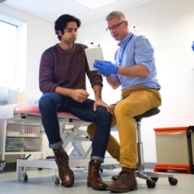

Working with People and Communities Strategy 2022/23
Taking public involvement to a collective new level

Slide 2
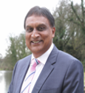

Foreword
We have a unique opportunity to transform the way health and social care services are designed and delivered in Staffordshire and Stoke-on-Trent. Working with partners, we want to rebuild new and improved services in a different way to ensure they address inequalities and better support individuals, families and communities now and in the future.
This the start of a journey where we focus our collective efforts to strengthen and support connections, conversations and relationships with local people and communities, to make sure that we put them at the heart of everything that we do.
We need to continually listen to all of our local people to make sure that our services are truly user-designed, effective, joined-up and accessible to all.
We need to understand what is good and what needs to be improved – regardless of who people are or where they live. Everyone is equally important in our eyes, and that will be our guiding focus as we move forward in a new more joined-up and collaborative way of working.
These are exciting times, and we hope that our partners, local people and communities are excited to be coming along on this journey with us.
Prem Singh
Chair Designate of the Integrated Care Board
Peter Axon
Interim Chief Executive Officer
of the Integrated Care Board

Slide 3
Introduction
Public engagement and involvement has always been recognised as a key enabler in supporting effective service planning and delivery across Staffordshire and Stoke-on-Trent. However, there is also a recognition that we could do better.
We could strive to reach more of our local people and communities, including children and young people and those furthest away from health and care services. We could listen harder to them and better understand their wants and needs.
Working with people and communities, we want to understand what is working and what is not from their perspective, learn from previous mistakes, and involve them more in our service planning and decision-making processes. This will help to ensure that services are delivered in the right place, at the right time, for the right people.
We want to have a better understanding of the local population, including the wider determinants that influence their health and wellbeing, such as housing or employment, and use our collective strength to tackle the health and care challenges that local residents face.
We cannot do this effectively without drawing on the diverse thinking of those who know the issues best – local people and those who need our services. So we will work with our partners to listen to, and collectively act on, the experiences and aspirations of local people and communities.
We will work hard to ensure we have the channels in place to continuously engage with our populations – not just on our priorities, but the priorities of our local communities. We will stay in a permanent ‘listening mode’, so we can truly hear what people are saying.
We will use this opportunity to reset the relationship between the public and the NHS, to one where people are treated as active partners in the community, rather than passive recipients of services, and we will empower them to better look after their own health and wellbeing.
As a new Integrated Care Board (ICB) we now have an opportunity to strive further and harder than ever before to ensure that people and our communities really are at the heart of all of our decision making – putting them and their needs at the heart of everything that we do.

Slide 4
Purpose and aim of the strategy
Involve
Service user experience
Intelligence
Place networks
The purpose of this strategy is to support the four key aims of the ICS, to:
  improve outcomes in population health and healthcare
  tackle inequalities in outcomes, experience, and access
  enhance productivity and value for money
  help the NHS support broader social and economic development.
It will outline our new approach to public engagement and involvement, including the key principles that will underpin our new ways of working.
It will describe more collaborative methods of working with people, communities and partners, including through the Integrated Care Partnership (ICP), networks at Place, Healthwatch and the voluntary, community and social enterprise (VCSE) sector.
It will provide a blueprint for new collaborative working to ensure that how we involve people, how we respond to their views and experiences, and how we identify and share the impact of involvement, are really aligned.
It is underpinned by other frameworks and plans which will support us to ensure that we have consistency and alignment in our ways of working across the whole system.

Slide 5
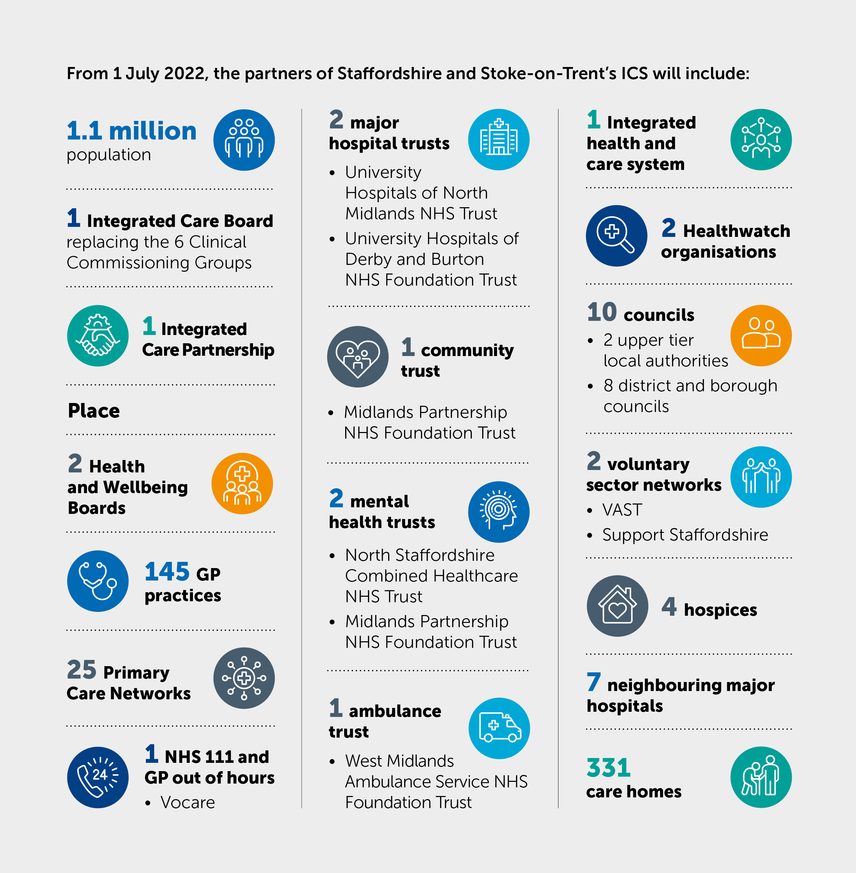
Who we are
Staffordshire and Stoke-on-Trent Integrated Care Board (ICB) is a new statutory organisation that is responsible for arranging NHS services for local residents
We are part of the Staffordshire and Stoke-on-Trent Integrated Care System (ICS), which is a partnership of organisations responsible for the health and care of 1.1 million people living across 1,048 square miles.
Our vision is to work with our people and local communities to make Staffordshire and Stoke-on-Trent the healthiest places to live and work.
All our partners are committed to make our vision a reality, and to make a real difference by:
  putting residents first
  delivering joined-up, person-centred care closer to home
  giving residents and staff the confidence that the changes being made are the right thing to do for them.
  We have developed an ambitious transformation programme, created shared clinical and professional leadership, and we are determined to reduce inequalities through integrated working.

Slide 6
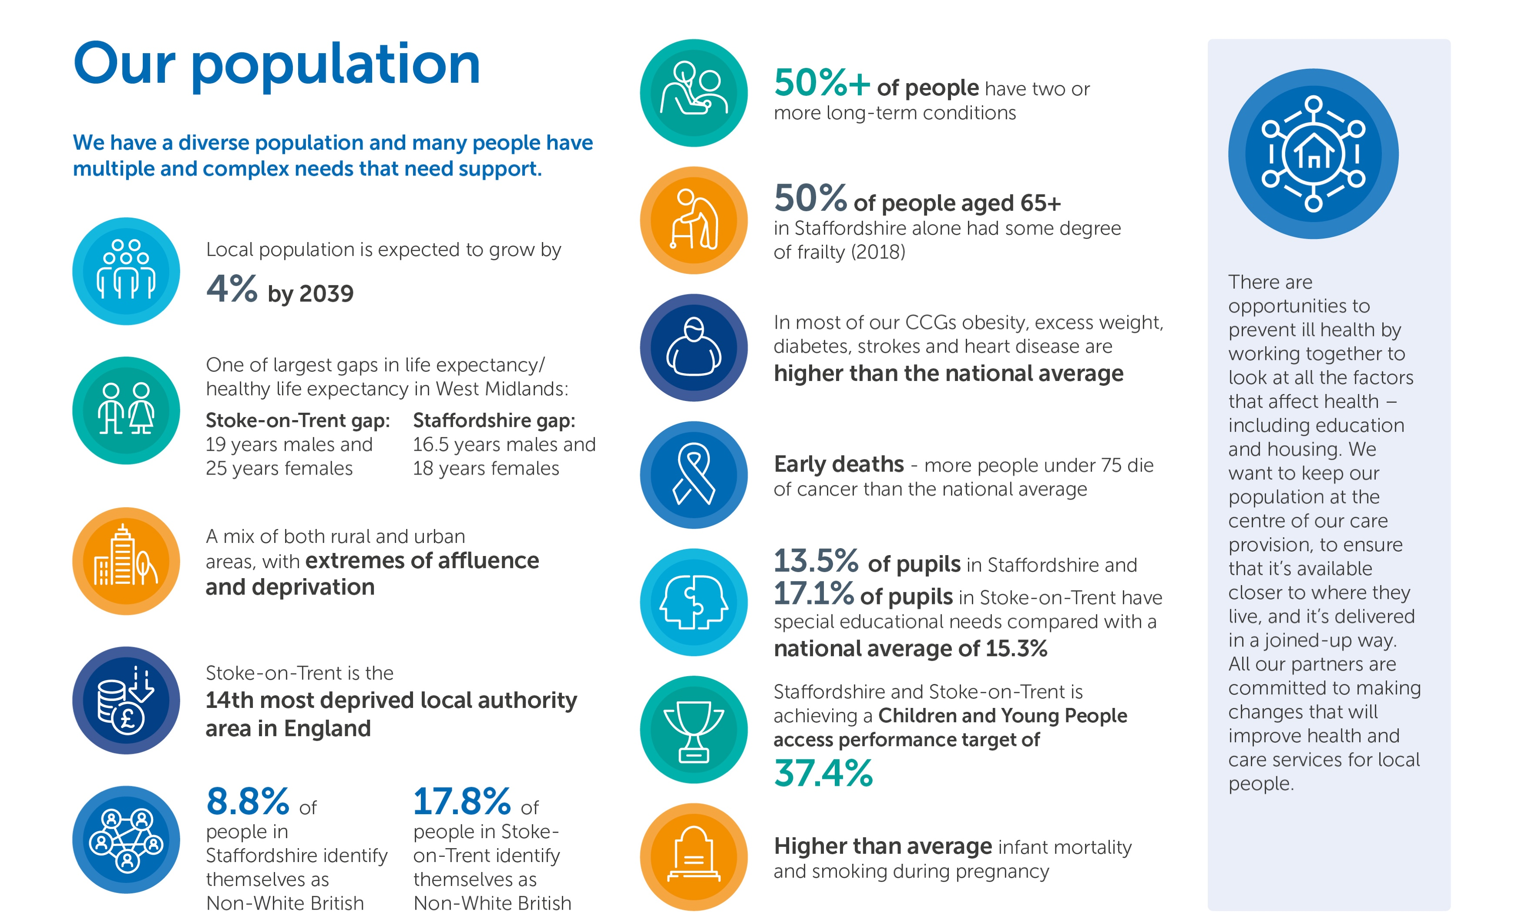
Our population

Slide 7
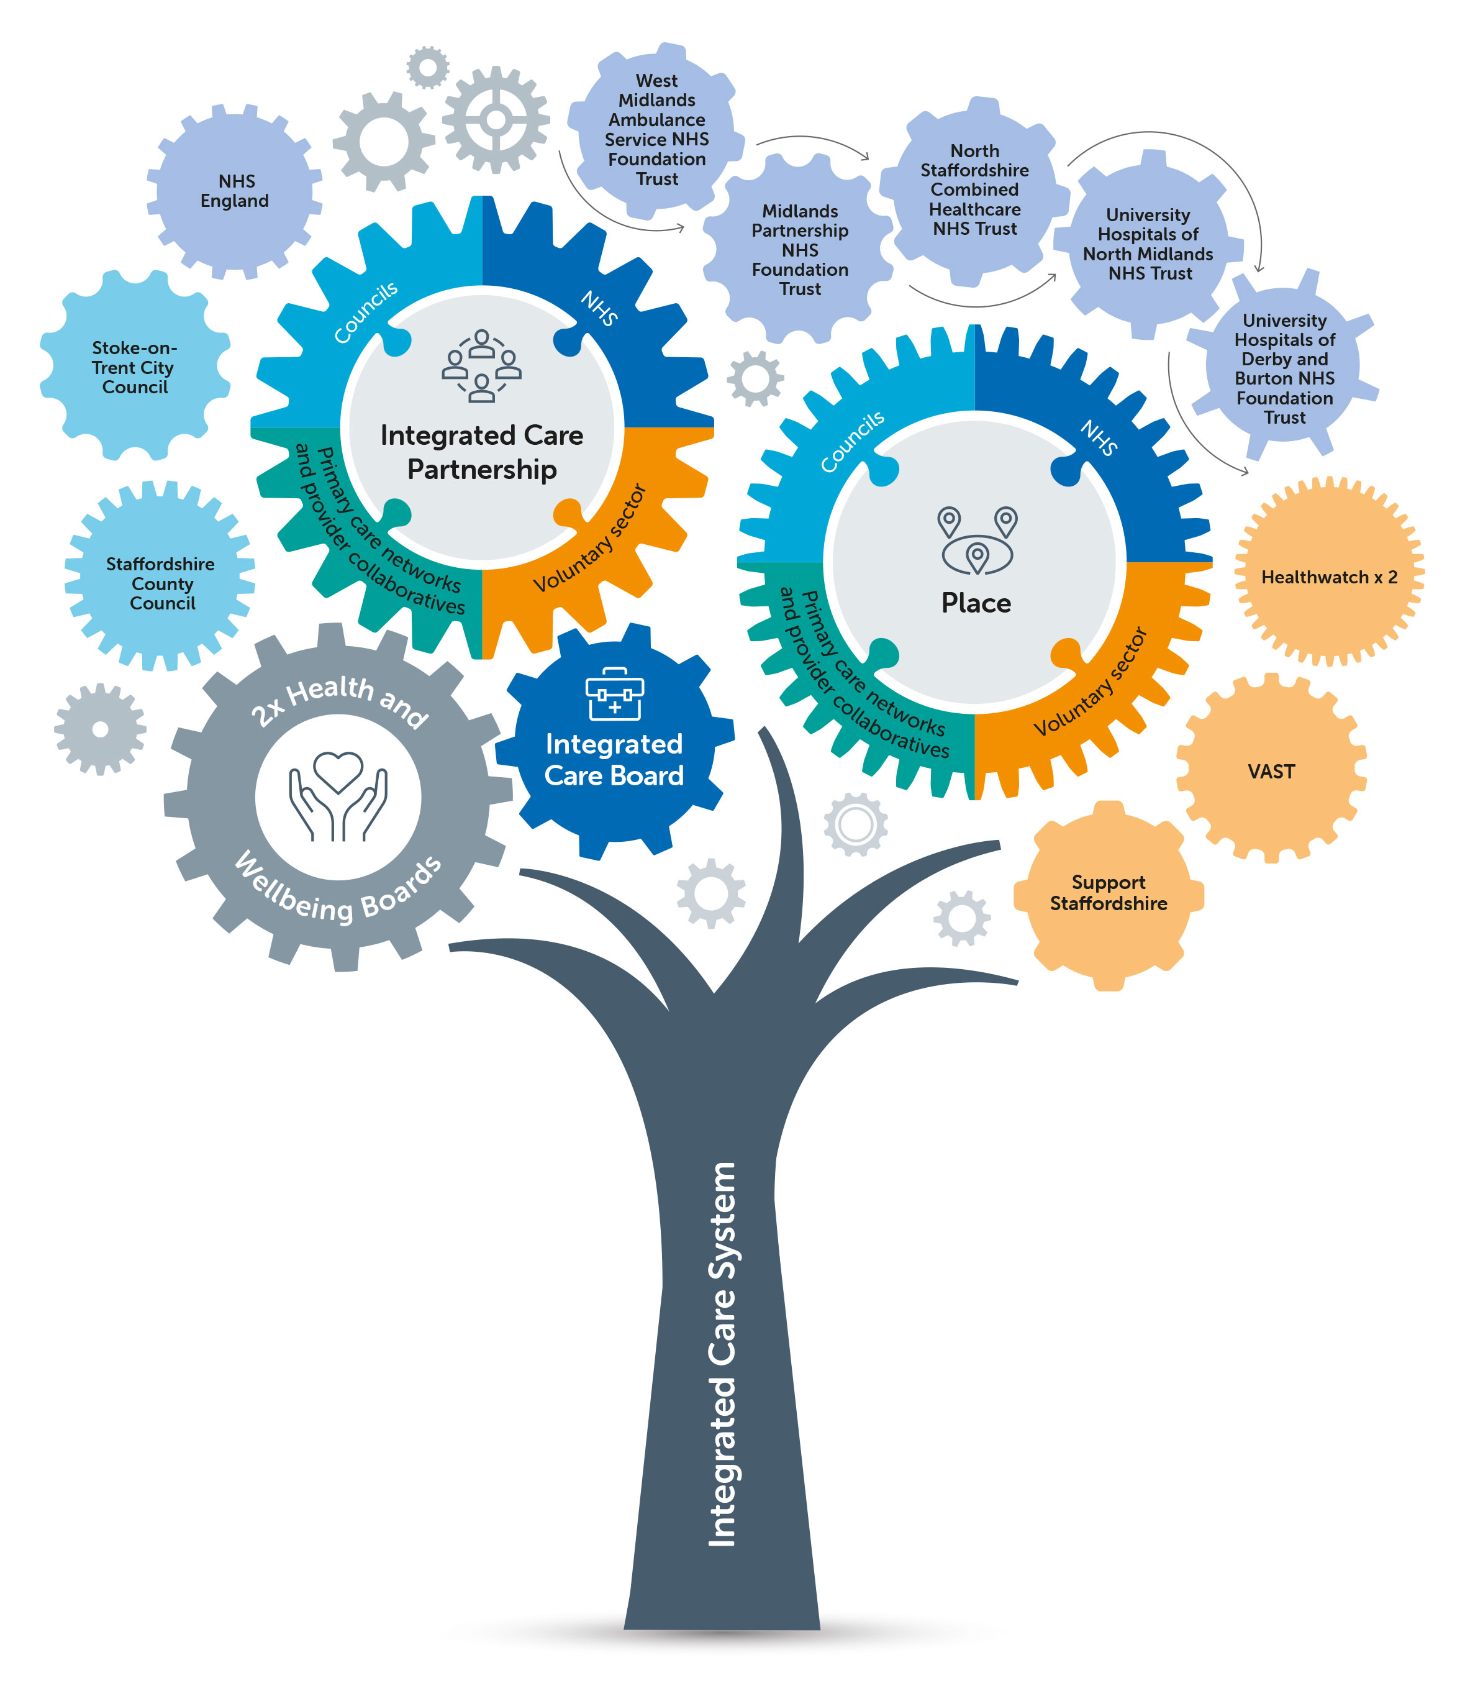
How we work together
We are reforming how we work across the health and care system to meet the needs of the whole population, with a commitment to empowering decision-making at a local level.
We recognise the significant opportunities that can be gained through greater integration of public sector and partner organisations. Connecting them through an effective, locally-owned, integrated system of leadership and architecture across all levels and areas.
There are already strong relationships with our two councils, Staffordshire County Council and Stoke-on-Trent City Council, which have been strengthened during our collective response to COVID-19. We want to embed and further develop effective system working arrangements as we develop the Integrated Care Partnership (ICP).
2
2
2
3
1
Health and Wellbeing Boards and Strategies
Overview and Scrutiny Committees for Health and
Social Care
Healthwatch partners
VCSE Alliance partners –supported by a Memorandum of Understanding
Health and Care Senate – clinical and professional leadership

Slide 8








Our leadership compact
Trust
Courage
Openness and Honesty
Leading by Example
We will be dependable: we will do what we say we will do and when we can’t, we will explain to others why not
We will act with integrity and consistency, working in the interests of the population that we serve
We will be willing to take a leap of faith because we trust that partners will support us when we are in a more exposed position.
We will be ambitious and willing to do something different to improve health and care for the local population
We will be willing to make difficult decisions and take proportionate risks for the benefit of the population
We will be open to changing course if required
We will speak out about inappropriate behaviour that goes against our compact.
We will be open and honest about what we can and cannot do
We will create a psychologically safe environment where people feel that they can raise thoughts and concerns without fear of negative consequences
Where there is disagreement, we will be prepared to concede a little to reach a consensus.
We will lead with conviction and be ambassadors of our shared ICS vision
We will be committed to playing our part in delivering the ICS vision
We will live our shared values and agreed leadership behaviours
We will positively promote collaborative working across our organisations.
Respect
Kindness and Compassion
System First
Looking Forward
We will be inclusive and encourage all partners to contribute and express their opinions
We will listen actively to others, without jumping to conclusions based on assumptions
We will take the time to understand others’ points of view and empathise with their position
We will respect and uphold collective decisions made.
We will show kindness, empathy and understanding towards others
We will speak kindly of each other
We will support each other and seek to solve problems collectively
We will challenge each other constructively and with compassion.
We will put organisational loyalty and imperatives to one side for the benefit of the population we serve
We will spend the Staffordshire & Stoke-on-Trent pound together and once
We will develop, agree and uphold a collective and consistent narrative
We will present a united front to regulators.
We will focus on what is possible going forwards, and not allow the past to dictate the future
We will be open-minded and willing to consider new ideas and suggestions
We will show a willingness to change the status quo and demonstrate a positive ‘can do’ attitude
We will be open to conflict resolution.

Slide 9
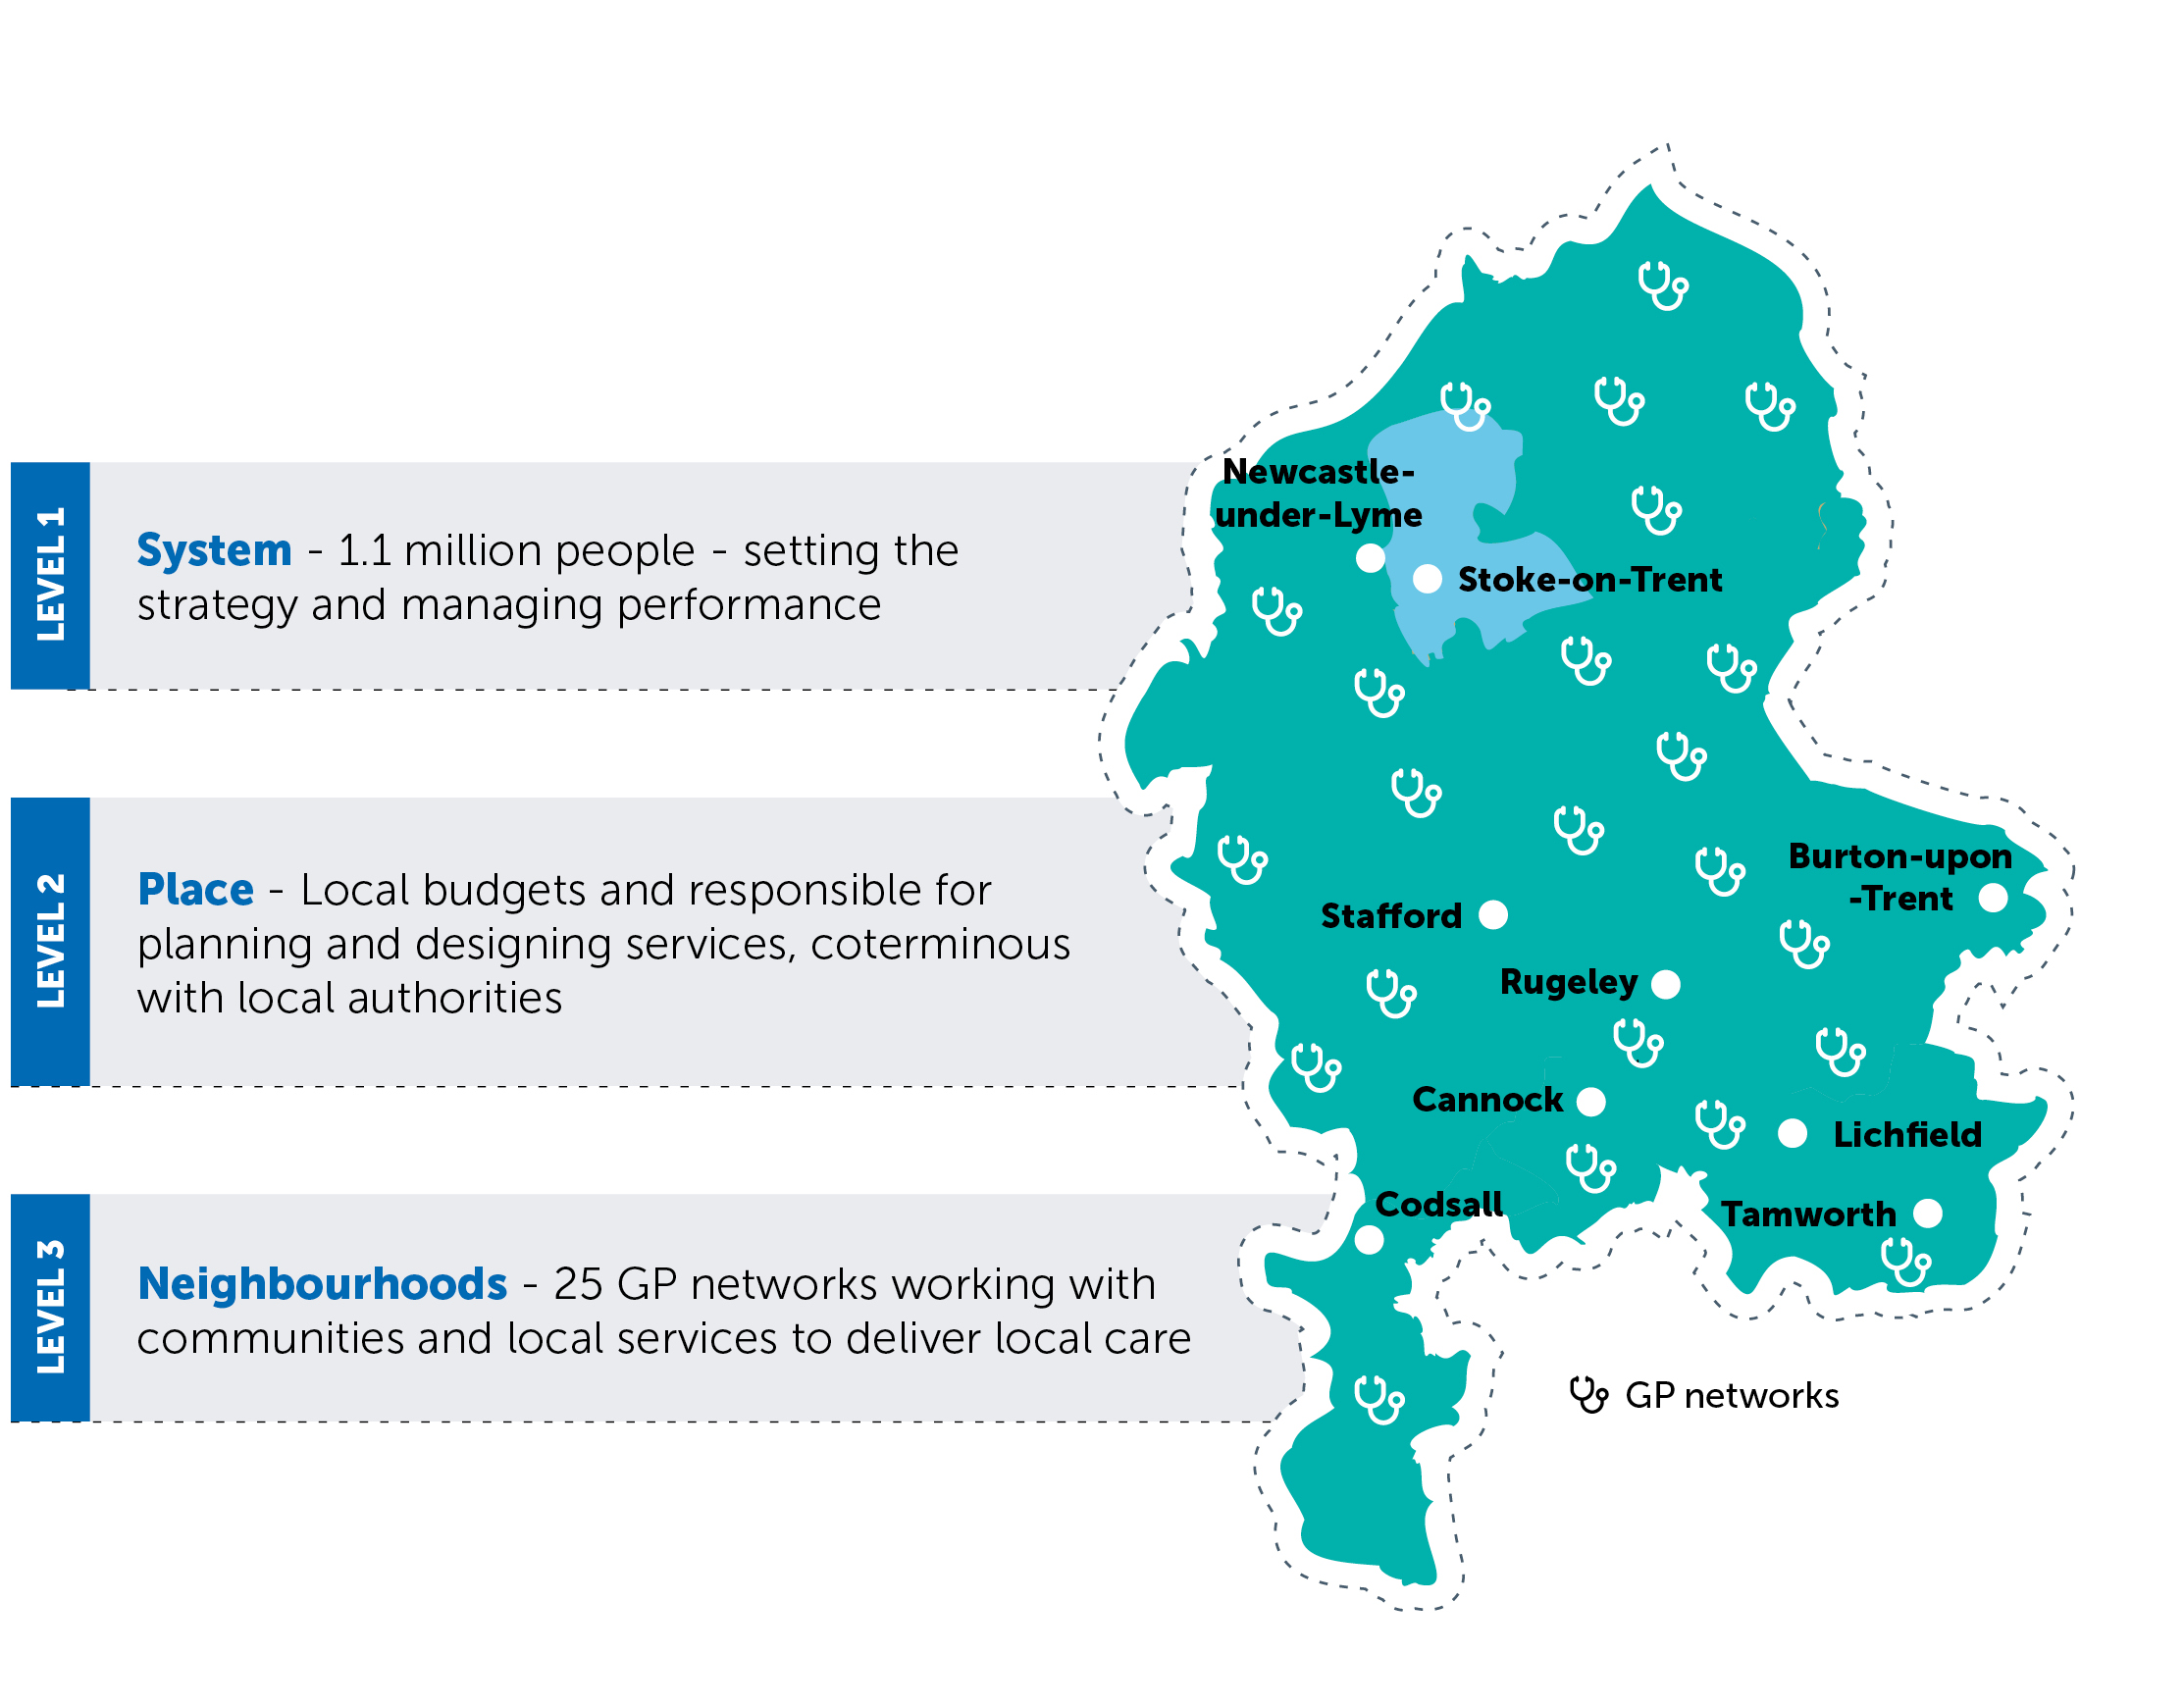
Building something different – place-based working
To work effectively, our integrated care system will need to promote collaboration between lots of different organisations, NHS teams and local people.
We recognise the need for local delegation – for local NHS staff be in charge of running our services.
We are developing networks at place to support our 25 Primary Care Networks (PCNs).
To link up our communities and neighbourhoods, we will develop and grow place-based engagement and involvement networks.
We will establish a dedicated resource in each area. They will work with our networks of organisations and local people of all ages to help us increase our reach and active involvement with our diverse communities, enabling us to hear from and involve people in our work.

Slide 10
Establishing the public voice at place
To rebuild new and improved services that address inequalities and better support individuals, families and communities, we need to listen to local people. We need to go out into communities and talk to people about the issues that matter to them and find out what we can do to support them. Many of these conversations are already happening – even if it is informally amongst families and friends. Working together, we need to find ways to listen to what is being said and put channels in place to make sure the public feels they are being heard.
Our networks at place will have a key role to play in this:
  understanding the needs and challenges of the local population
  supporting conversations with communities about their priorities as well as those of the local NHS
  building relationships to increase trust and improve participation
  ensuring staff, the public and local communities are involved in discussions and receive feedback on how they have made a difference
  embedding our principles of engagement at the heart of planning, priority setting and decision-making
  using feedback from people and communities to develop programmes of work that address inequalities
  proactively seeking the views of children and young people as service users of the future
  Through better two-way engagement with people and communities, we will support people to be the ‘primary providers of their own health and care’ – being supported to:
  prevent their own ill health
  intervene early when they do get ill
  manage their own conditions if they become more serious.
  Involving members of the public in our work is more than just a legal or moral duty, it is about supporting them to embrace the change that is critical to its very success.

Slide 11
Provider Collaboratives and Primary Care Networks
Provider collaboratives are being established to support relationships and collective engagement between providers to make services better
Together with networks at place, the provider collaboratives will seek to understand where gaps and opportunities exist at a system and local level. They will agree priorities using Population Health Management (PHM) and variation data, which provide more detail about communities, including how they compare to each other.
Provider collaboratives are ideally placed to support the ongoing collection of data from people – not just about their experience of services, but also data that will provide the ICB with a better understanding of the local population and support early detection of inequalities.
The collection of data to tackle inequalities and to support the management of the wider health and care system is covered under articles 6.1.C, 6.1.E and 9.2.H in the UK General Data Protection Regulations.
Regular collection of data, including demographics and protected characteristics, will increase our knowledge of the health and wellbeing needs across Staffordshire and Stoke-on-Trent.
Primary Care Networks (PCNs) bring general practices together
Geographically based, the networks are focused on service delivery, rather than on the planning and funding of services, but are in the best position to understand the population health and care needs at a grassroots level.
PCNs will have an important role to play in taking a proactive approach to managing population health and assessing the needs of their local population to identify people who would benefit from targeted, proactive support.
They also provide the opportunity to communicate and engage with patients at a local level through established channels such as websites, social media platforms and patient participation groups.

Slide 12
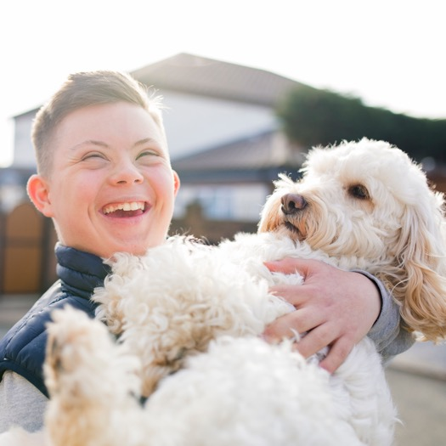

Working with local people – progress and challenges to date
We have a strong track record of involving staff, service users and health and care partners across our ICS. This has enabled us to gather local data, intelligence, and insight, to effectively inform our plans and priorities.
We recognise the invaluable role that VCSE organisations can play to support us in proactively reaching out and involving seldom-heard groups such as deprived communities, children and young people, ethnic minority communities, as well as those with disabilities, sensory impairments, the homeless and travelling communities.
Understanding the views of local people has helped us to explore ideas such as the smarter use of technology, providing care in different settings closer to home, and looking for new ways to reduce health inequalities.
But we know we need to continually look for new ways to strengthen our networks and adapt our communications, engagement, and operational delivery – to enhance our understanding of the needs of our diverse population.

Slide 13



Working with local people – progress and challenges to date
Population and demographic data was a key driver in the rollout of the
local COVID-19 vaccination programme
The new regulatory guidelines, principles and approaches are not new to us as an emerging and evolving ICB and ICS. Instead, they are a strengthening and expansion of existing networks, relationships, approaches and arrangements that in turn will support:
    joining up practices, processes and ways of working
    recognising the value and impact of working differently
    maximising resources for impact
    sharing intelligence and reducing duplication
    reaching wider and deeper into communities and amongst seldom heard groups
    building on existing networks and relationships, as well as those emerging at a system and place-based level
    working collaboratively with partners, the public, and the VCSE sector.
We are developing
a central database of local intelligence to support partners and enhance Population Health Management data
Partnership support across the NHS, councils, police, fire and VCSE was key to the success of our system response to COVID-19

Slide 14
Evolving community engagement and involvement
In developing our strategy, we have built on the foundations already in place across the health and care system:
Processes in place to enable the public vice to be heard and used to shape the design and delivery of services.
A Local Resilience Forum C&E group to coordinate a joint C&E response to system priorities.
Healthwatch and voluntary sector partners actively involved at Board level through a Memorandum of Understanding.
Aligned community networks to support two-way, system-wide conversations, including the digital People’s Panel and the face-to-face local representatives’ group. These are supported by face-to-face groups at a community level.
An integrated approach to communications and engagement (C&E), with an ICB director of communications who is able to coordinate joint activities of all partner organisations.
Community engagement mechanisms established across partners within the ICS – including community champions and a Communities2gether forum to identify and address inequalities and to inform and shape engagement and involvement activities.
Investment for a central C&E resource for the ICS, led by the director, that supports system transformation and coordination.
Regular reporting on engagement activity into the ICS Partnership Board to inform priorities.
C&E leaders across all partners leading on specific priorities, using their individual expertise, and reporting to the system group.
Strong relationships with the overview and scrutiny committees and Healthwatch to inform our approach to involvement.
Robust governance arrangements in place through a C&E system group, with members from all partners, including the councils, Healthwatch and the voluntary, community and social enterprise (VCSE) sector.
Partnership working with the VCSE sector to support the development of VCSE Alliances at a system and local level.

Slide 15
Evolving community engagement and involvement
In addition, we have further developed our system approach to working with people and communities through:
Using feedback from the public and community to shape an overarching system-wide, people and community engagement and involvement strategy. The strategy will continue to evolve and align to the development of the Integrated Care Partnership, including localised strategies developed by partner organisations.
Identifying examples of best practice and learning, resources and community champions across the ICS, to optimise our collective effectiveness around community engagement.
  Having C&E leads represented on each of the voluntary and community engagement groups and transformation projects, to ensure effective representation of the public voice and consistent onward and outward messaging and engagement with local communities.
Developing agreed principles and approach to support the development and delivery of consistent messages, materials and activities across all system partners’ engagement channels.
Ambitious aspirations to build on our economies of scale, collective strengths and ways of working, to create a ‘true’ enhanced system-wide approach to community engagement.
Developing a database that will hold valuable data around patient experience and inequalities to support all our partners within the ICS. A database that will also enhance our Population Health Management data to support better planning at a system and local level.
Developing a clear and ‘common purpose’ at both a local and a system level with
a consistent narrative and key messages. This is supported by a single newsletter, to streamline, amplify and reduce dilution of messaging to collective staff and
the public.
Strengthening our People’s Panel to more accurately reflect the demographics of our collective population and developing a system-wide ‘People’s Assembly’ to advise on involvement and engagement activities, ensuring they are accessible to all.

Slide 16
Core local principles
In Staffordshire and Stoke-on-Trent, we wanted to develop a core set of principles that all ICS partners could sign up to for working with people and communities. We wanted the principles to reflect how local people would like to be engaged, and would empower them to become active participants in their own health and wellbeing.
Working with existing partners, patient and community groups and VCSE sector organisations throughout the summer and autumn of 2021, we developed the following principles, most of which echo the principles that are set out within the national ICS implementation guidance on working with people and communities:
1
Health and wellbeing are everyone’s business – engagement needs to be inclusive and accessible to all.
2
Put the public voice at the heart of decision-making.
3
Don’t make assumptions – ask how best to engage.
4
Recognise the different needs of the population, especially those who could be excluded.
5
Do it once and do it well – shared intelligence between partners.
6
Allow enough time to engage properly, adapting the approach where necessary.
7
Be honest, open and transparent – authentic involvement.
8
Clear communication that can be understood by all – be clear on what you are asking and consider your audience.
9
Commit to feedback – explain what impact engagement has made in simple terms.
10
Build on what is already there – utilise existing knowledge, relationships, experience and local assets and channels, including the community and voluntary sector.

Slide 17
Next steps
Over the next 12 months, we will continue to develop and evolve our strategy for working with people and communities. Working with our partners, we will:
Set up regular Community Conversations, where health and care professionals can come together with the public and community stakeholders to discuss health and care issues.
Identify and fill any gaps in our reach into communities and groups with protected characteristics under the Equality Act – including children and young people.
  Work with our Provider Collaboratives and Primary Care Networks to develop and strengthen their approach to public and community involvement.
Explore and invest in digital solutions, such as social listening software, that would enable us to monitor and respond to public sentiment about people’s experiences of health and care services.
Work with community groups and those with reach into local communities to broaden our understanding of our population – including the issues that matter to them and how we can work better together.
Increase and improve our use of insight and intelligence, including qualitative feedback, to complement clinical data and analytics as part of the evidence for decision making.
Develop a framework of engagement across the NHS, councils
and wider partners, ensuring a fully coordinated and mutually supportive approach.
Deepen and develop trusted relationships with local residents, communities and partner organisations.

Slide 18
Creating a new way of working to tackle health inequalities
COVID-19 underlined how health inequalities can only be addressed by listening to and understanding the needs, views and opinions of our local population – many of whom are not currently heard.
We need to address this to ensure we are working in a more accessible way, to reach those whose voices are too often ignored or not sought.
We need to maintain continuous engagement to detect issues early and put mitigations in place.
We need to proactively ask our communities what priorities matter the most to them – as well as asking them to help input and shape the priorities of the ICB.
We also need to recognise that all communities are different, which can impact and influence health and wellbeing, as well as service outcomes and experience and inequalities.
This equally applies to how we approach communications and engagement and the need to tailor our methodology and materials accordingly.
Our new strengthened ways of working as a larger, more joined-up collective, will enable us to really start to:
  create stronger relationships with people in our local communities, to start to improve health outcomes
  approach them as active partners and participants in their own health, wellbeing and community – rather than being passive recipients of services
  really understand what matters to them
  develop ICB plans and priorities with them
  provide the most personalised, effective NHS services
  make the NHS equally accessible to all.
We want to continue to build on and enhance our approach to people and community engagement and involvement, to ensure it:
  is transparent, effective, and meaningful
  is responsive and focused on the individual
  accurately reflects the diverse needs of our population
  embraces learning from all partners, whilst ensuring high quality, safe health and care and support.

Slide 19
Takeaways from COVID-19
The pandemic has altered the way we engage with people. It forced us to broaden our thinking and accelerate transformation, particularly towards digital engagement.
It enabled us to have far greater levels of engagement and collaboration amongst staff, local people and VCSE sector.
The pandemic emphasised the importance of understanding and tackling health inequalities and of working directly with communities to understand their needs, reliably identify potential barriers, and design solutions for the benefit of local health and wellbeing.
It identified the seldom-heard groups who needed a more targeted approach to communication and engagement, to ensure that information is inclusive and accessible.
We established the Communities2gether forum to focus on the needs of seldom-heard groups. Representatives joined us from wider equality and health inclusion groups. The forum developed resources and used their communication channels to spread the key messages. Feedback from the community was used to identify examples of good practice, and areas for further focus.
Vaccine hesitancy provided new challenges around engagement and behaviour change, and forced us to think more creatively about the best ways to communicate.
We encouraged partners, third sector and VCSE organisations to use our Patient Intention Survey to capture thoughts, feedback and have discussions with community groups where we knew uptake of the vaccine was low.
Working with faith leaders, we learned about the issues for some groups. Using this valuable insight, we introduced:
    information in appropriate languages to improve vaccine uptake in Bangladeshi, Pakistani and Black communities
    information in The Muslim Council of Britain ‘Safer Ramadan’ guide that was later used nationally
    pop-up vaccine clinics in mosques and community centres which improved uptake by 23%
    GP-led virtual sessions in different languages
    interviews with a variety of radio stations where GPs talked about hesitation, concerns and Ramadan.

Slide 20
Transformation
We have a strong history of involving people and working with partners across Staffordshire and Stoke-on-Trent to reach our diverse communities, to ensure everyone has the chance to be involved (with support available if required).
Involvement work started in 2019 with a Listening Exercise. This was paused in 2020 in response to COVID-19, and was restarted in 2021, with a refresh of previous activity. We wanted to understand if anything had changed, if there was anything new, and if the pandemic had impacted on experiences of health services.
The pandemic created a number of challenges and opportunities, with a need to shift to ‘Digital First’ instead of face-to-face discussions and involvement opportunities (retaining traditional methods where possible). Recognising the barriers this might have created for some, we developed a series of robust approaches:
Accessibility – managing and monitoring how we support people for whom English is not their first or preferred language, or who face barriers to online routes (sensory impairment, infrastructure/connectivity, access to devices, skills)
  Voluntary sector partnerships – a new approach to build on existing relationships with partners to either:
    reach their networks with communications and updates, including invitations to participate
    attend their events to provide an update, hear views and answer questions
    support voluntary sector partners to translate online meetings and events
    access our extensive network of translation partners to provide materials in a range of alternative formats.
    Learning from COVID-19 – reaching our diverse communities via established networks of Trusted Voices and Trusted Faces (people who are already living and working in the area, and in many cases in contact with communities we have historically struggled to reach). This has helped us understand communities better, appreciate their different cultural priorities and concerns, and benefit from increased use of our networks and community relationships.
We are continuing to review alternative ways of providing virtual events to allow face-to-face participation.
We continue to review the best methods to deploy – based on current guidance and the audience we are involving.

Slide 21
Meeting our legal obligations for public involvement
Within the guidance there is also an expectation that:
      as a strong and effective ICB, we should have a deep understanding of all our people and communities
      the insights and diverse thinking of our people and communities are essential, and will enable our ICB to tackle the health inequalities and other health and care challenges that our communities face
      the creation of our new statutory ICB will bring fresh opportunities for us to strengthen our work with our people and local communities, by building on existing relationships, networks and activities.
Statutory duties around public involvement for NHS organisations are currently being reviewed and will be published in the summer of 2022, following a period of consultation. It is anticipated the revised guidance will build on the principles set out in the ‘ICS Implementation Guidance on Working with People and Communities (September 2021)’ and be assumed by the new ICB.
Current legislation requires us, as a new ‘collective’ or system of health and social care partners, to involve members of the public (particularly, those with protected characteristics) in all of our work to reduce health inequalities.
The NHS has also a legal duty to engage on substantial service change, guided by the local overview and scrutiny committees.
The legislation aims to ensure that everyone can access the services they need, at the most appropriate time, in the most appropriate place and in the most accessible way, and, to have equally high outcomes regardless of background or location.
It also aims to ensure that the population’s views and experiences are sought and responded to in a systematic way to inform and support planning and commissioning of services to local health priorities.
The ‘ICS Design Framework (2021)’ suggests that as partners of an ICS, we should agree how we listen consistently to, and collectively act on, the experience and aspirations of local people and communities. We should support people to sustain their own health and wellbeing, as well as involve people and communities when developing plans and priorities and continually improving services.

Slide 22




Governance and assurance
We want our communication, engagement and involvement principles to be woven into the fabric of our ICB. It needs to be a golden thread in all of our corporate governance structures, systems, processes and procedures, and connected to the ICB Constitution. As such, we have started to take steps to achieve this, by having:
Community Champion at Board level
A Non-Executive Director responsible for championing the public voice and promoting our work on health inequalities as well public engagement and insight. With a seat on our new ‘People Assembly’, the Non-Executive Director will provide ICS knowledge to the group, and share insight and feedback to the ICS Board.
VCSE partnership working
The ICB is working in collaboration with partners to establish a recognised model for voluntary, community and social enterprise (VCSE) sector engagement and involvement.
The model will deliver recognised means of engagement, involvement and empowerment for health and care partners to work collaboratively with the VCSE sector, at both a system level and within communities.
Support Staffordshire and VAST are leading
the development of VCSE forums, that will feed into a system VCSE Alliance.
The system VCSE Alliance will be closely linked to the ICB and ICP supported by a Memorandum of Understanding.
We are also working closely with SCVYS (Staffordshire Council of Voluntary Youth Services) to strengthen our engagement with children and young people.
Health and Wellbeing Boards
Locally there are two HWBBs (one for each council), and the NHS is represented on both. They have an important role to play, given their responsibility for producing the Joint Strategic Needs Assessment (JSNA).
Scrutiny Committees
We have strong relationships with both scrutiny committees, and regular engagement and involvement enables a constructive and transparent process of scrutiny. There is a strong commitment to work in partnership with our local authority colleagues at a system and local level.
Insight at system and local level
All system and community insight and feedback (including public consultation) will be integral in supporting service design and delivery team decision-making. Our virtual People’s Panel will strengthen our community voice and representation during key decision-making processes. s

Slide 23

Monitoring patient experience
How you can provide feedback to the ICB about your experience of local services
Telephone: 0300 123 1461 between the hours of 8.30am until 4.30pm
By post :-
  NHS Staffordshire & Stoke-on-Trent Integrated Care Board
  Stafford Education & Enterprise Park,
  Weston Rd,
  Stafford,
  ST18 0BF
Feedback from people about their experience of local services is a fundamental part of the quality and quality improvement process. Many of the channels we have in place are able to capture this feedback informally – often anonymously – but this information can then be considered alongside feedback received through formal processes.
Patient Experience Reports – provide an overview of key themes and trends of patient feedback relating to providers – including actions taken in response to concerns. Includes contacts to Patient Advice and Liaison Service (PALS), complaints and MP letters.
Annual complaints analysis – includes complaints that directly relate to commissioned services and those handled on behalf of external providers.
Soft intelligence – we have a central system that enables patients, the public and healthcare professionals to provide feedback on local services. All soft intelligence is clinically reviewed and taken to a monitoring group for assurance, review of themes and trends or a multidisciplinary review.
Learning Disabilities Mortality Review (LeDeR) – a programme that undertakes a review of all deaths involving individuals with learning disabilities aged four years and over. The aim is to improve the quality of health and social care service delivery for people with learning disabilities, reduce premature mortality and health inequalities and influence practice at individual, operational and strategic levels

Slide 24
Emerging Stakeholder Framework
Integrated Care Partnership
Intelligence
Health and
Wellbeing Boards
ICB – statutory involvement
People’s Assembly
Observatories
Involvement
Place-based networks
Population Health Management
Virtual People’s Panel
Engagement
Provider Collaboratives
Health and Care Senate
VCSE Alliance
Neighbourhoods
Insight
NHS providers
inc. Primary Care Networks
Councils
Healthwatch
Staffordshire and Stoke-on-Trent
VCSE – inc.
Health Communities Forums
Experience
One-to-one service user and clinician/professional interface

Slide 25


Role of the VCSE sector in the ICS
The Voluntary, Community and Social Enterprise sector plays an essential role in health and social care.
The ICB will work closely with our VCSE partners, including VAST, Support Staffordshire and SCVYS, to provide the necessary support, including resource and training, to strengthen their capacity and capability as an active partner.
The VCSE sector is a vital cornerstone in progressive health and care systems and has a key role to play in:
ICB governance
Supporting the capability and functions of the ICB to deliver integrated care
System, strategic, workforce and operational plans
Shaping, improving and delivering services and developing and delivering plans to tackle wider determinants of health
Population Health Management – capturing and shaping data, intelligence and insight into the needs of people and communities

Slide 26


The VCSE partnership working model
The model will deliver a recognised means of engagement, involvement and empowerment for the VCSE sector to work collaboratively with the NHS.
Healthy Community Forums will work across Staffordshire and Stoke-on-Trent to:
focus on working collaboratively with the NHS to jointly deliver the best outcomes for our communities
unify the VCSE sector voice – providing insight, expertise and challenge
facilitate the spread and scale of innovative practice and effective partnership working
reduce barriers to volunteering and partnership working.
Next steps:
Support Staffordshire and VAST are leading the transition of existing VCSE forums into VCSE Healthy Communities Forums which will align to ‘place’
These forums, supported by a coordination group, will together form a system VCSE Alliance
The System VCSsE Alliance will be closely linked to the Integrated Care Partnership and the Integrated Care Board
The VCSE Alliance will be in place by July 2022.

Slide 27



The VCSE partnership working model
Staffordshire and Stoke-on-Trent Healthy Communities Forums
The Healthy Communities forums will work with people and communities across Staffordshire and Stoke-on-Trent to:
support the NHS to effectively engage, consult and empower VCSE organisations
reduce health inequalities within Staffordshire and
Stoke-on-Trent communities by working with local communities
provide a strong collective voice for the role of the VCSE sector and bring VCSE sector knowledge, skills and expertise to address health inequalities.

Slide 28
Understanding our local population
Communications and engagement activity across the ICS, involving council and NHS colleagues, will be of significant importance if we are to empower local people to take shared responsibility for their health.
It will help us to better understand the behaviours and causes of poor health within our communities as well as supporting the possible solutions.
This will require an improved understanding of our local population. We will work with our colleagues in the councils to understand the social, economical and environmental factors that influence health.
We will work with representatives who are trusted voices within communities to help deliver important health messages in a way that is helpful and easy to understand.
We will make 'every contact count’.
We will work with our provider collaboratives to collect data that will give us a better understanding of our current service users and to identify potential gaps or areas of inequality.
Place will also have a pivotal role to play in developing a deeper understanding of local communities and supporting better outcomes, through targeted priorities and work plans.
We will overlay information from partners with local intelligence from our communities to understand their needs, wants and barriers, as well as experience of existing services across the county and the city.
We will share what we know about people and communities across all partners.
We will produce a clear strategy to tackle health inequalities, which will incorporate the knowledge and expertise from partners and stakeholders within the ICS.

Slide 29
Putting the public voice at the heart of everything
People and communities are at the heart of everything we do. We also recognise that we need different approaches to ensure that the public voice is heard. The proposals below will continue to develop as we move forward as an ICB and have the potential to support involvement and engagement across the integrated care partnership in the future.
A system-wide People and Communities Assembly – which will report to the ICB through the Quality Committee. The membership will align with the Voluntary Sector Alliance and the Health and Care Senate and act as an advisory board to the ICB on it’s approach to involvement and engagement, supporting targeted engagement with seldom heard communities.
A People’s Panel – an online panel of local people who will carry out and support regular survey research amongst local communities. The panel is largely ‘demographically representative’ of the population, but will be developed further to provide a robust and flexible way for the ICB to put people’s aspirations and experience front and centre of all that we do.
A system-wide Intelligence Observatory – a resource developed with council colleagues. The central observatory will help to reduce duplication and support a more efficient and effective use of resources across all partners. It will also help to alleviate involvement fatigue and frustration from communities, who feel they are constantly repeating the same information several times to multiple partners – supporting the principle of ‘do it once and do it well’.
Community Champions – council-led champions, providing a direct link into communities at a grassroots level, supporting greater insight into communities across Staffordshire and Stoke-on-Trent and the issues that matter to people, including the barriers that local people have around being able to access services.
Online forums – using platforms to support engagement on different topic areas as well as the opportunity for people and communities to highlight the priorities that matter to them.
Regular Community Conversations – NHS professionals discuss NHS issues with the public and stakeholders.
Social Listening software – to understand the issues that matter most to people and how they are feeling about them.
A stakeholder bulletin – developed using input from all partners (but managed centrally) and adapted and tailored to communicate targeted key messages to staff and local communities across Staffordshire and Stoke on Trent.

Slide 30
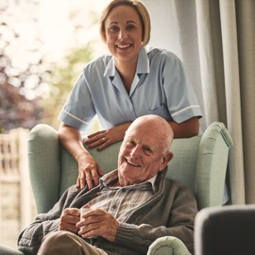


Supporting Behaviour Change
If we are to truly understand the needs of our local population and to engage with them effectively, we need to involve and work with all of our partners.
We need to build on the relationships and connections that partners may have to reach deeper into communities so we can listen to what people have to say.
We need to better identify and understand the diverse and varied aspects within our communities, in terms of their demographics, lifestyle profiles, wants, needs, motivations and barriers.
We need to link population and public health data and insight together, to develop campaigns that give people the information they need.
We need to understand the barriers that some people face and to help people understand the changes they can make to improve their own health and wellbeing.
This in turn, will support our ambition to encourage and enable local people to be active partners in the community, rather than being passive recipients of services, and empower them to better look after their own health and wellbeing.

Slide 31
Operating Plan Priorities 2022/23
1. Workforce
2. COVID-19
3. Elective care
4. Urgent and emergency care
5. Primary care
Invest in our workforce with more people
Look after our people
Improve belonging in the NHS
Work differently
Grow for the future.
Delivery of the COVID-19 vaccine programme
Continue to meet the needs of patients with COVID-19
New treatments for COVID-19
Post-COVID-19 services.
Maximise elective activity and transform delivery of services
Improve performance against cancer waiting times standards
Diagnostics
Deliver improvements In maternity care.
Improve the responsiveness of urgent and emergency care
Transform and build community services capacity to deliver more care at home
Virtual ward models
Improve hospital discharge.
Improve timely access to primary care
PCN Initiatives
Direct enhanced services
GP recruitment and retention
Dental services, community pharmacy and optometry.
6. Mental health, learning disability and autism
7. Population health, prevention, health inequalities
8. Digital technologies
9. Resources
10. Establish ICB
Grow and improve mental health services
Maintaining continued growth in mental health investment
Meeting the needs of people with a learning disability and/or autism.
Develop our approach to Population Health Management
Prevent ill-health and address health inequalities
Using data and analytics to redesign care pathways.
Exploit the potential of digital technologies to transform the delivery of care and patient outcomes
Achieving a core level of digitisation in every service across systems.
Make the most effective use of our resources
Moving back to and beyond pre-pandemic levels of productivity
Financial framework.
Establish ICBs and collaborative system working
Working together with councils and other partners across ICS to develop a five-year strategic plan.

Slide 32
Priorities for 2022/23 building on recent successes
1
The ICB has identified some significant priorities that need to be focussed on in the year ahead, to help to improve services and the health and wellbeing of our local communities. To support the delivery of these priorities, we aim to build on the learnings from the COVID-19 vaccine roll out as much as possible.
2
We will work with our staff, local people and wider communities, and build on our new strengthened partner and voluntary and community relationships and their engagement and involvement channels.
3
We will use effective engagement to support the ICS’s transformation programme, which aims to improve, develop, transform, maximise and grow local services
4
These aims will be the focus of our annual engagement and involvement action plan, which will evolve and develop over the year.
5
We recognise the power of digital now more than ever. We intend to focus on continuing to review alternative ways of providing virtual events where required (or provide a blended approach of face-to-face and virtual). We will enable larger groups of people in face-to-face environments to participate in conversations that are important to them.
6
We will further explore assisted technology that could support engagement with seldom heard groups as well as software to enable us to identify and tap into conversations, away from our traditional channels.
7
Throughout all of our activities, we will focus on ensuring that we put local people first. We will ensure that every single individual has a voice and an opportunity to use that voice, to help inform and shape our collective service transformation, improvement and delivery plans.

Slide 33
Supporting our people
Our staff are already at the forefront of integrated working and we are building a culture of ‘one workforce’ across Staffordshire and Stoke-on-Trent.
We want our staff to feel valued, supported, empowered and equipped to provide excellent quality, compassionate and safe care, wherever they live or work.
We will strive to affect positive change across the whole workforce; allowing collaboration, opportunities and increasing our overall staffing numbers.
We will engage and involve the workforce in designing how we achieve ‘one workforce’ – including opportunities for them to work with their peers to redesign ways of working, rotational roles and cross sector working.
Our Interim People Plan 2022-2023 and Beyond sets out our approach to delivering the national guidance for ICB People Functions to support a sustainable ‘one workforce’ within health and care.
Working with our partners, we will:
  empower staff to influence the work of the ICB by creating an inclusive culture and providing clarity of vision and objectives
  create new and enhanced internal communication channels across the system – including opportunities for feedback and ideas
  engage staff as advocates of the ICB and our partnership approach, ensuring there is a fuller understanding of our overall aim and objectives
  enable staff to see what the partnership means for them and their future
  support recovery of system services
  involve staff earlier when developing and delivering transformation that addresses the system's underlying financial deficit and supports clinical/workforce sustainability
  involve staff in the transition of the NHS from a provider and commissioner model into an ICS landscape – including the emergence of NHS provider collaborations

Slide 34
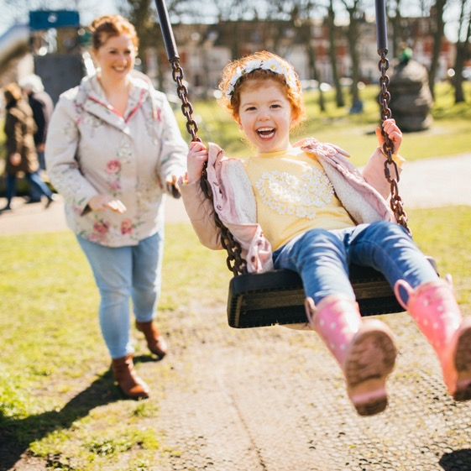
Monitoring and evaluation
We will continuously monitor and evaluate our live engagement and involvement strategy to ensure that it remains effective.
An annual plan will be developed to deliver the strategy. The plan will be developed and tested in partnership with local people across our communities, to ensure that it is fit for purpose.
Regular performance and ‘temperature check’ reports and measures will provide key performance indicator (KPI) metrics around the annual plan, including:
  reputation management
  media analysis
  public polling
  citizen engagement.
These metrics will be regularly monitored and reviewed, and used to inform reports back to the Integrated Care Board on progress and performance.

Slide 35


Monitoring and evaluation
The metrics we will be looking to include are:
  quantitative data – measuring the activities undertaken, for example media releases, events, promotional materials
  quality of coverage – especially for earned media, the take-up and interpretation of stories in the media, commentary, and what others are saying about us
  analytics – measuring uptake, for example who reads our material, website hits, social media activity
  qualitative data – capturing opinions and feedback
  surveys – capturing changes in attitudes and perception, measuring satisfaction
  feedback on engagement and involvement programmes, including consultations
  behavioural change – in response to specific initiatives
  benchmarking with other ICBs, using common indicators such as assessment frameworks and integration index, along with a peer-review process through the ICB development pathway.

Slide 36
Appendices

Slide 37
Co-development with communities
Involve
Service user experience
Intelligence
Place networks
  To develop our new approach to working with people and communities, we wanted to speak to as many people and groups that we could to understand:
  what was currently working well from their perspective
  what could be improved, including the barriers or challenges for communities wanting to get involved
  how could we extend our reach and ensure a more representative voice is able to shape and inform the work of the ICS at a system and place-based level.
    This rich insight informed the co-development of a set of ‘Core Local Principles’, which all system partners signed up to. The principles have been used to shape this new strategy for engaging with people and our communities, which will continue to evolve and develop.
Engaging communities and partners to shape the strategy
Mapping
Planning
Delivery
Online survey to map existing groups and networks and to understand what is/is not working
Targeted engagement with partners, seldom-heard groups and PBP leaders
Focus groups to discuss survey findings and develop desired principles of engagement
Develop a
core set of principles for engagement and
co-production
Develop system-wide strategy on working with people and communities
Develop a recognised model for VCSE sector engagement
Effective engagement to support ICB and ICP at system level
Effective engagement to support PBPs
Effective engagement to understand and address inequalities
Effective engagement to support health and wellbeing of local populations

Slide 38





Developing our approach to future engagement and involvement
We worked collaboratively with our partners, the public and the community and voluntary sector, to develop a new approach to community engagement and involvement that is transparent, effective and meaningful.
We are building on existing structures to develop a People’s Panel that will reflect the demographics of the population and enable people to have their say regardless of who they are or where they live.
During summer 2021, we engaged with existing groups and community networks to understand how partners were involving people and communities, including seldom-heard groups or groups representing communities with protected characteristics. We also heard about what has been working well and what could be improved.
We want to strengthen our work on tackling inequalities by working with groups such as the Local Equality Advisory Forum and Communities2gether so that people who are seldom heard can have a voice.
We involved these groups in developing a core set of principles for all partners to sign up to. The principles reflected how the public would like to be engaged with, and would empower them to become active participants in
their own health and wellbeing.
We will work with partners, the public and the VCSE to identify opportunities for the codesign or coproduction of services, where clinically it is possible to do so.
We are working to strengthen local networks with the voluntary and community sector, to inform future engagement activity and build on established channels for two-way engagement.
We used feedback from our engagement to develop our system-wide strategy for engaging with people and communities that supports the 10 principles set out in the ICB implementation guidance on working with people and communities.
The ICB will continue to iterate and re-validate its vision with the community and provide clear and regular updates on plans to achieve its vision and on progress made in implementing these plans.
We are working with the councils to develop a system-wide observatory of local intelligence to help partners identify existing inequalities and to understand the impact these have on opportunities for health and wellbeing.

