Slide 1

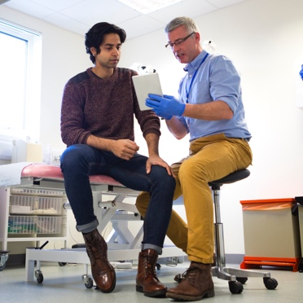

Integrated System Performance and Programmes Highlight Report
30th August 2023
Prepared by the Transformation Delivery Unit and ICB Finance & Intelligence team

Slide 2
Overview
This report contains for discussion:
An executive summary outlining key headlines and escalations.
An overview of programme delivery and exceptions which includes
  a proposed methodology on a system RAG rating for discussion.
A placemat that demonstrates at a high level key metrics and deliverables within the 2023/24 operating plan.
Exception reporting against our One Collective Aim and 4 system priorities.
A further detailed set of appendices is included providing more information on:
Portfolio Programme Highlight Reports (Appendix 1) where portfolios provide an update on key operational, transformational, workforce, quality, finance, contracts, procurement issues, along with requests for another portfolio/enable and recommendations or escalations.
Efficiency Delivery Plan (Appendix 2) where leads outline oversight on the efficiency programme performance, current status on actions and key headlines including any escalations. This includes areas such as CHC (Continuing Healthcare), Estates and Medicines Optimisation.
National NHS objectives 2023/24 Performance (Appendix 3) providing detail on activity and/or performance in relation to the plan and/or target. A Red Amber Green (RAG) rating is applied to the M3 position (and M4 where available).
Ctrl and click on any underlined text for further detail.

Slide 3
Executive Summary
Headlines
One Collective Aim - Category 2 calls show an 8% increase on the previous month. Category 3 calls are not only up on the previous month but are also up by 18.5% on the same month last year. Falls continue to be the largest proportion of Category 3 calls (21% of the total in July).
Urgent and Emergency Care (UEC) - Emergency Department (ED) Attendances have fallen for the second consecutive month and are 2.7% down on the corresponding period last year. Figures for the 3rd week of the month show no impact on attendance numbers over the Industrial Action period. Virtual Ward usage is at 70% utilisation in the North, with the East at 23% and the South West 0%.
Tackle Backlogs (Planned Care) - Eliminating 104+ and 78+ week waiters remains a significant challenge, however improvements have been made in 65+ and 52+ week waiters with UHNM currently reducing long waits in these cohorts of patients ahead of plan.
General Practice/Primary Care – Full time equivalent (FTE) numbers recruited in to Additional Roles Reimbursement Scheme (ARRS) roles continue to increase month-on-month but remain below plan. Dental –Units of Dental Activity (UDAs) are increasing but are well below the Q1 plan by 347,997 units.
Complex Individuals – This cohort of patients form a key focus of the system recovery plan. With further detail being developed through that process alongside the broader metrics.
Efficiency Programme – The system has delivered £44.5m of efficiency as of July 2023, 75% of plan, which is an 11% increase on last months delivery levels. Forecasts project the system will recover most of this position by year end, although there is a high level of risk within this forecast due to the size of the efficiency target within the plan.
Escalations
One Collective Aim – Category 2 and 3 calls have increased in July. August activity will be available mid-September to identify if this is a continuing trend or a one-off during July. The projects identified within the system recovery plan should start to have a positive impact on these metrics from the Autumn onwards.
Urgent and Emergency Care – Utilisation of virtual ward capacity is not consistent across the geography, with further work required to improve the position in the East and South West in particular. Surge planning for 2023/24 is underway - with no de-escalation through the summer there remains concerns on achievement of the level of mitigation required to offset the bed gap.
General Practice/Primary Care – No additional funding has been provided for the General Practice Winter surge plan. Portfolio will need to resolve within current allocations.
End of Life, LTCS and Frailty (ELF) - All portfolio work relating to the operational plan has been scaled back temporarily until the end of August to focus on the ELF recovery plan.
Efficiency Programme – Key challenges remain to deliver recurrent efficiency within the current environment. We currently have a £12.7m forecasted shortfall of recurrent schemes. This has improved by £15m from last month's forecast.
There are no escalations identified by other Portfolios.
Ctrl and click on any underlined text for further detail.

Slide 4
Overview of One Collective Aim and 4 System Priorities (EXAMPLE for discussion)
One Collective Aim | OVERALL RAG STATUS | WHAT’S DRIVING THE RAG STATUS?
Reduce the number of Category 2 and 3 ambulance calls | Red | Category 2 calls show an 8% increase on the previous month whilst Category 3 calls are not only up on the previous month but are also up by 18.5% on the same month last year, A contrasting position to the aim of reducing Category 2 and 3 ambulance calls.
System Priority | OVERALL RAG STATUS | WHAT’S DRIVING THE RAG STATUS?
1. Urgent & Emergency Care Focus on prevention, hospital avoidance and appropriate and timely discharge | TBC | There are two key national metrics for UEC and they are both (2/2) performing below plan/target: 4 hour A&E waits and bed occupancy. If we applied the methodology below, this would result in a RAG status of RED
2. Tackle Backlog (Planned Care) Backlog reduction | TBC | There are 6 key national metrics for Planned Care and 2/6 are performing below plan/target: 65 week waits and theatre utilisation performance. If we applied the methodology below, this would result in a RAG status of RED
3. General Practice Ensuring that residents have appropriate, timely and equitable access to services | TBC | There are 6 key national metrics for Primary Care and 2/6 are performing below plan/target: ARRS roles and Dental Recovery. If we applied the methodology below, this would result in a RAG status of RED
4. Complex Individuals Improving access to high quality and cost effective care for people with complex needs, which requires multi-agency management | TBC | There are 8 key national metrics which are aligned to Complex Patients. 2/8 are performing below plan/target: CYP Community Mental Health Access and recovery of dementia diagnosis rates. This cohort of patients form a key focus of the system recovery plan. If we applied the methodology below, this would result in a RAG status of RED
**PROPOSED METHODOLOGY for discussion at SPG Any national metric rated RED defines the overall rating for the system priority (see next slide for detail)
Notes:
Alex Robinson
The NHS Framework for Integrated Care defines ‘complex needs’ as:
Multiple, i.e. face a number of different challenges
Severe, i.e. not responding to standard interventions
Persistent, i.e. long term rather than transient
Framed by family circumstances, e.g. early family circumstances, loss, inequality, prevalence of Adverse Childhood Experiences

Slide 5
Key national NHS metrics (in red) and key deliverables (as set out on slide 6) have been aligned across the four system priorities. Any national metric rated RED defines the overall rating for the system priority.
Further work will be undertaken following discussion at SPG.
Proposed methodology on a system RAG rating for our priorities (EXAMPLE for discussion)
System Priority | Key Deliverables (those in red bold text are national metrics) | RAG M3 | **Proposed system Priority RAG
UEC | CYP LYC Programme |  | R
 | Capital Investment Programme | TBC
 | 76% A&E patients seen within 4 hrs
 | 92% Bed Occupancy
 | Review / Priority Setting Virtual Wards
 | Enhance provider collaborative offer to include CAS | TBC
 | Deliver fully integrated discharge HUB | TBC
 | Improve Crisis pathways including 111 and ambulance response
 | 2 hour Urgent Care Response
 | Streamline direct access (SPA) | TBC
Planned Care | Implementation of PIFU |  | R
 | Eliminating 65 week waits
 | Meeting 85% day case
 | Meeting 85% theatre utilisation
 | Introduce CDCs
 | Optimal use of lower GI 2 week pathway
 | % patients seen < 7 weeks for diagnostics
 | 7 test total waiting
 | Outpatient follow ups (no procedure)
 | Reduce 62 day breaches
 | 28 day faster diagnosis stranded
 | Diagnosis Stage 1/2 Cancer | TBC
System Priority | Key Deliverables (those in bold text are national metrics) | RAG M3 | **Proposed system Priority RAG
Primary Care | Deliver additional ARRS roles |  | R
 | Implement digital solutions to provide enhanced remote monitoring | TBC
 | Recover dental activity
 | Implement POD delegation
 | GP appointment < 2 weeks | TBC
 | Increase GP appointments
 | Increase % of patients with hypertension treated to NICE guidance | TBC
 | Increase % of patients 25-65 years with a CVD risk score greater 20% on lipid lowering therapies | TBC
Complex Patients | CYP Community MH Access |  | R
 | Inappropriate OOA placements | TBC
 | Adult Community MH Access
 | Recover dementia diagnosis rate
 | Children with Complex Needs
 | PICU Options Appraisal
 | Minimise waiting times - autism diagnosis
 | Increase no of people accessing IAPT
 | Perinatal MH service access | TBC
 | Increase in no of people with SMI having a physical health check
 | Reduction in reliance on inpatient care - adults / children
 | Develop Palliative and End of Life Strategy
 | Identify patients in last 12 months of life
 | Develop Long Term Conditions Strategy
 | Develop Long Term Conditions Transformation Programme
 | Deliver Frailty Strategy
Other | Implement national delivery plan for maternity / neonatal care |  | N/A
 | Systemic implementation of Core 20 Approach | TBC
 | Implement LTP Prevention Programme
 | Utilise PHM Techniques
 | Reduce stillbirths | TBC
 | Reduce infant mortality | TBC
 | Reduce serious intrapartum brain injury | TBC
Notes:
Alex Robinson

Slide 6
Overview of key underpinning deliverables
Ctrl and click on the portfolio heading box for further detail on programme delivery and performance.
Children and Young People / Maternity
Planned Care, Diagnostics & Cancer
Improving Population Health
Urgent and Emergency Care
Mental Health, Learning Disability and Autism
Primary Care
End of Life, LTCS and Frailty
Design and Implement Long Term Conditions Programme:
Asthma
Epilepsy and
Diabetes
Implement Children with Complex Needs Project
Implementation of the national delivery plan for maternity and neonatal care
Ongoing implementation of Patient Initiative Follow Up (PIFU)
Trajectory for eliminating 65 week waits delivered
Meeting 85% day case /theatre utilisation
Introduce Community Diagnostic HUBs
Optimal use of lower GI 2 week pathway
Systematic implementation of the Core20 approach
Implement NHS Long Term Plan prevention programmes
Utilise population health management techniques
Implement Capital Investment Case
76% of patients seen within 4 hours in A&E
Bed occupancy 92% or below
Full review and priority setting for virtual wards.
Enhance provider collaborative offer to include the Clinical Assessment Service.
Deliver a fully integrated discharge “hub”
Improve the crisis pathways including 111 and ambulance response
Undertake a Psychiatric Intensive Care Unit (PICU) Options Appraisal
Minimise waiting times for autism diagnosis
Increased number of people accessing Improving Access to Psychological Therapies (IAPT) services
Increased number of people with a Serious Mental Illness (SMI) having annual physical health check
Deliver Additional Roles Reimbursement Scheme (ARRS) recruitment
Implement digital solutions to provide enhanced remote care to people.
Deliver recovery of dental activity
Implement Pharmacy, Optometry and Dental (POD) Delegation
The creation of a Palliative End of Life Care (PEoLC) strategy
Identification of Patients in the last 12 months of life recorded on Palliative Care Registers in Primary Care
The creation of a Long Term Conditions (LTC) strategy
Transformation programme around Cardiovascular (CVD), Respiratory
and Diabetes
Delivery of the frailty strategy
TRAFFIC LIGHT KEY:
On track Deliverable behind plan, but mitigations in place to try and improve the position
Behind plan and no mitigations identified as yet to improve position in year Complete
Measure of success not yet defined by portfolio
Notes:
Alex Robinson

Slide 7
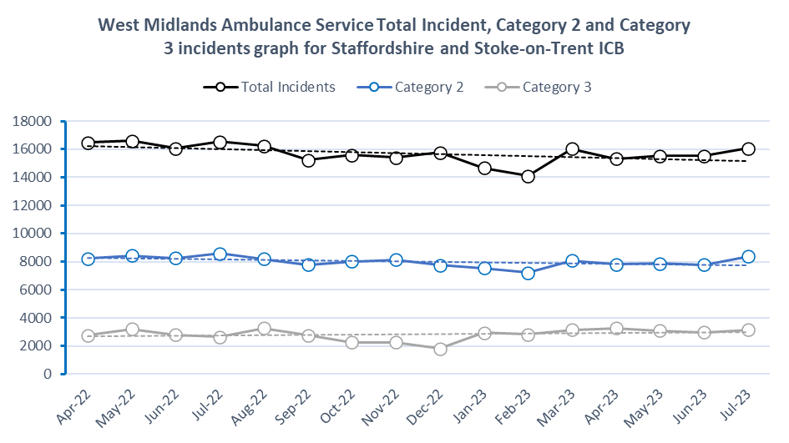
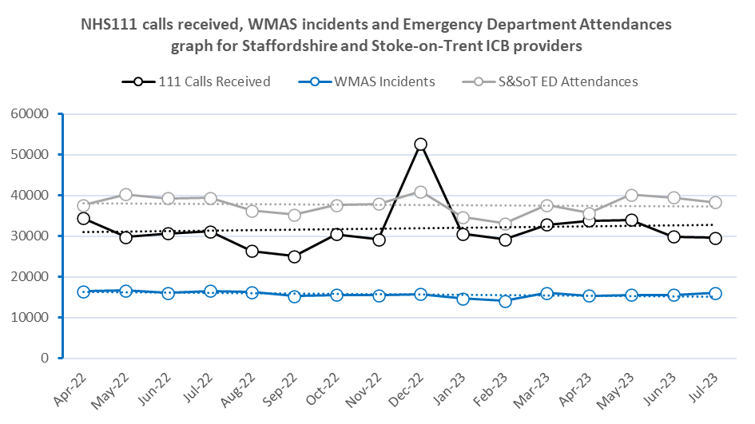
Exception reporting against our One Collective Aim
One Collective Aim | Key markers for success this month, actions and points to note
Reduce the number of Category 2 and 3 ambulance calls The data provided here are the incidents derived from calls to West Midlands Ambulance Service (WMAS) for our ICB only. Charts run from April 2022. Not all July 2023 data was available at the time of publication | Category 2 calls show an 8% increase on the previous month whilst Category 3 calls are not only up on the previous month but are also up by 18.5% on the same month last year, a contrasting position to the aim of reducing Category 3 calls. The majority of the increase within Category 2 calls are attributed to calls designated as Medical or Medical Minor. Whilst breathing problems increased less than seen in previous years for the corresponding period, falls continues to be the largest proportion of Category 3 calls reported with 21% of the total number in July.
 | Emergency Department (ED) Attendances have fallen for the second consecutive month, and whilst there were fewer attendances in July than the corresponding month last year, it still recorded higher than the monthly average for 2022/23. The total number of 111 calls during July 2023 fell by 4.8% when compared to the same period of 2022/23, the second month in a row of reduced volumes in comparison to last year.
 | University Hospitals of North Midlands (UHNM) through their work with WMAS have been moved into Tier 2 of the national support mechanism. Monitoring against contractually agreed trajectories continues with Category 2 Mean Response times falling below 30 minutes through the end of July 2023.
Notes:
Lead Rob Aherne (BI) Slide to populate

Slide 8
Exception reporting against our 4 system priorities (1)
System Priority | Key points this month or actions and observations for the coming months
1. Urgent & Emergency Care Focus on prevention, hospital avoidance and appropriate and timely discharge | 4-hour performance in July (at UHNM) improved to 69.6% but below the plan of 77.4%. Data for August details the continued fluctuation performance but no day in August so far has exceeded the target (for August). Virtual Ward (VW). In July 26% utilisation was recorded, well below the 80% threshold. VW usage is greater in the North with over 70% utilisation across both Chronic Obstructive Pulmonary Disease (COPD) and General Medicine virtual wards. Virtual Ward usage in the East is at 23% and the South West 0%. General & Acute (G&A) bed occupancy reduced in July to 90%, above plan of 84.9% and below the national ceiling of 92%. Ambulance handover delays remained challenging in July, with increases in >15, >30 and >60 minutes delays. The number of >60-minute delays (783) is the highest this financial year to date. Referrals into Acute Care @ Home increased slightly in July remaining above 1600 at 1622 (52 per day on average). Surge planning for 2023/24 is underway, with no de-escalation through the summer there remains concerns on achievement of the level of mitigation required to offset the bed gap which modelling has shown to be predominantly Medical in nature. Performance improvements evident at UHNM (through their work with West Midlands Ambulance Service (WMAS)) has meant the Trust have been moved into Tier 2 of the national support mechanism. Monitoring against contractually agreed trajectories continues with Category 2 Mean Response times falling below 30 minutes through the end of July. To support system level recovery priorities a series of working groups reporting through the Access Group are focusing on improvements to support admission avoidance.
2. Tackle Backlog (Planned Care) Backlog reduction | 65+ week waits at UHNM are currently below the plan (of 1,680) at 1,383 in June. Eliminating 78+ week waiters remains a significant challenge, due in part to the industrial action, 104 are forecast for the end of September. UHNM forecast two 104+ week breach in August (due to a complex pathway) and zero (104+) breaches in September – a notable improvement. Diagnostic activity was below plan in June (across the 7 core tests by 6.6%). The number of patients seen in <6 weeks increased by 2.3% (across the 7 core tests) from May but the percentage seen in <6 weeks (at 68%) was below the plan (of 73.2%). 62 day cancer breaches at UHNM reduced in June to 119, below the plan of 170. At the time of reporting, the latest UHNM position (w/e 13th August) shows an increase in the 62 day backlog The 104 day backlog (latest UHNM position (w/e 13th August)) has decreased to 148 and is below trajectory. 28 day faster diagnosis standard (FDS) was above plan in June at both UHNM and across the ICB population (for all Providers).
Notes:
Lead Rob Aherne, UEC and Mike Bradshaw Planned Care to update.

Slide 9
Exception reporting against our 4 system priorities (2)
System Priority | Key points this month or actions and observations for the coming months
3. General Practice/Primary Care Ensuring that residents have appropriate, timely and equitable access to services | The appointment count in General Practice increased in June and remains above the plan. June 2023 Did Not Attend (DNA) rate at 4.5% - unchanged from May and the joint lowest value since September 2022. Additional Roles Reimbursement Scheme (ARRS); the FTE continues to increase month-on-month, June 32 FTE greater than May. At 438 FTE, June is below the quarter 1 plan of 451.73 by 13.73 (FTE). A proportion of ARRS roles are currently not reported in the National Workforce Reporting Service (NWRS). Significant work is being undertaken to improve the accuracy of ARRS reporting and claims. ICBs are required to develop a system-level delivery plan for recovering access to primary care. The actions in the plan must align with the vision described in the Fuller Stocktake. The plan will be co-produced by primary care with relevant portfolios, leads and partners. Draft and final iterations of the plan will be presented at Finance & Performance Committee (FPC) in October and November for review and sign-off.
4. Complex Individuals Improving access to high quality and cost effective care for people with complex needs, which requires multi-agency management | Work has been expedited to develop the PIPs and associated metrics for End of Life, Falls Prevention and Severe Frailty as part of the System Recovery Programme. The remainder of the Frailty Programme and LTC Programme is currently on hold as part of a re-prioritisation of capacity exercise for at least 6 weeks. Continuing Healthcare (CHC) is a big ticket item in the system recovery plan which focuses on a range of patient cohorts with complex needs including those with Severe Frailty and End of Life. A CHC provider collaborative is currently in the process of being scoped to help tackle the quality and financial challenges affecting the current service model and to improve the interconnections with UEC pathways Access to NHS Talking Therapies saw an increase in June however the Q1 target of 7,367 has not been met. Actions are being taken to increase referrals. Access to Children and Young People (CYP) community mental health services was below the Q1 plan (by 4.6%). The Dementia diagnosis rate continues to exceed the national target, however it is below the plan in June. Learning Disability Annual Health checks data for July shows performance at 17% - a [financial] year to date high however (so far) below the Q2 plan.
Notes:
Lead Emily Ross, Primary Care and Mike Bradshaw/Clare Fox complex individuals to update.

Slide 10
Appendix 1:
Portfolio Programme Highlight Reports
Portfolios outline in the following slides key operational, transformational, workforce, quality, contracts and procurement issues, along with requests for another portfolio/enabler and items for escalation.
Notes:
Alex Robinson

Slide 11
Key to project RAG status
Key
Definition
LILAC
Scoping under way (includes Stage 1 Outline Case for Change for Provider Collaborative opportunities)
PURPLE
Scoping agreed and project now in initiation (includes Stage 2 Full Case for Change for Provider Collaborative opportunities)
GREEN
Mobilisation underway: Project on schedule
AMBER
Mobilisation underway: Project Behind Schedule but with mitigating actions to bring back on track
RED
Mobilisation underway: Project Behind Schedule with no mitigating actions to bring back on track
BLUE
Project completed / in closure

Slide 12
CHILDREN AND YOUNG PEOPLE Portfolio – Key Headlines including any escalations
OPERATIONAL / RECOVERY | TRANSFORMATIONAL | WORKFORCE, DIGITAL & ESTATES
Additional BAU projects, as appropriate, will be added to the dashboard to ensure full visibility of what is in the Operating Plan – this includes CYP Palliative & End of Life and physical health complex children. | Diabetes and Epilepsy projects rated AMBER as awaiting further NHSE guidance. Complex CYP (Physical Health) PIP expected at September Board for approval. Overview of the prevention workstream of the CYP Mental Health Programme received at the July 2023 Board meeting. System wide Infant Mortality Steering Group to be re-instated during September 2023. | Asthma Clinical Lead post recruited to and has commenced in post. Youth Workers in support of CYP diabetes out for recruitment. Interviews early September.
QUALITY | FINANCE, CONTRACTING & PROCUREMENT | REQUESTS FOR ANOTHER PORTFOLIO / ENABLER
QIA for Child Sex Exploitation going to panel 23/8/23 QIA for One Pscyhology pending safeguarding comments, not likely to require panel review | £19k funding agreed for Mental Health champions from NHSE to ensure that all children are appropriately supported in paediatric settings, with parity of esteem for mental health. Funding anticipated for SPOT PEWS (Paediatric Early Warning System) c£6k. | Need data analysis support from the IPH Portfolio in relation to the CorePlus5 agenda. Elective Recovery is a concern – limited visibility from a CYP perspective. This has been raised with the Planned Care portfolio. Board request for oversight and understanding of maternity issues relevant to CYP Programme.
ESCALATIONS
None

Slide 13
CHILDREN AND YOUNG PEOPLE PROJECT RAG STATUS AND METRICS AT A GLANCE (1)
PROJECTS | RAG STATUS
Diabetes Care Bundle | Awaiting NHSE guidance
Epilepsy Care Bundle | Awaiting NHSE guidance
Best start in life - improve the survival of babies and young children to reduce infant mortality | In Initiation
Increase the number of children and young people achieving and sustaining a healthy weight | In Initiation
Complex CYP (Mental Health) | In Initiation
PROVIDER COLLABORATIVE OPPORTUNITIES | RAG STATUS
Asthma Care Bundle | Stage 3 Mobilisation
KEY PORTFOLIO METRICS FOR MONITORING IN 23/24 | BASELINE | TARGET (annual) | Apr | May | Jun | Jul | Aug | Sep | Oct | Nov | Dec | Jan | Feb | Mar | YTD
Reduce hospital admissions for diabetes (flat activity) | 19/20 | 52.9 | 3.9 | 3.9 | 1.3 |  |  |  |  |  |  |  |  |  | 9.1
(Rates per 100,000 populated aged <18 years below) | 23/24 | 52.9 | 2.6 | 4.3 | 2.6 |  |  |  |  |  |  |  |  |  | 9.4
Reduce hospital admission for epilepsy (flat activity) | 19/20 | 83.6 | 6.1 | 8.7 | 7.4 |  |  |  |  |  |  |  |  |  | 22.2
(Rates per 100,000 populated aged <18 years below) | 23/24 | 83.6 | 6.4 | 7.7 | 6.8 |  |  |  |  |  |  |  |  |  | 20.9
Reduce hospital admission for asthma (flat activity) (Rates per 100,000 populated aged <18 years below) | 19/20 | 197.1 | 14.8 | 20.0 | 11.3 |  |  |  |  |  |  |  |  |  | 46.2
 | 23/24 | 197.1 | 7.2 | 8.5 | 8.1 |  |  |  |  |  |  |  |  |  | 23.9
Notes:
Tables to be updated in M4 report to reflect style, format and summary approach design on UEC slide.

Slide 14
CHILDREN AND YOUNG PEOPLE PROJECT RAG STATUS AND METRICS AT A GLANCE (2)
Staffordshire Local Authority |  | Apr | May | Jun | Jul | Aug | Sep | Oct | Nov | Dec | Jan | Feb | Mar
CYP in out of area residential care placements | Num | 70 | 86 | 82
 | Den | 119 | 128 | 124
 | % | 58.8% | 67.2% | 66.1%
Young adults in out of area residential care placements | Num
 | Den
 | %
Stoke on Trent Local Authority |  | Apr | May | Jun | Jul | Aug | Sep | Oct | Nov | Dec | Jan | Feb | Mar
CYP in out of area residential care placements | Num | 78 | 76 | 79
 | Den | 112 | 110 | 113
 | % | 69.6% | 69.1% | 69.9%
CYP in out of area residential placements >20 miles | Num | 42 | 40 | 43
 | Den | 78 | 76 | 79
 | % | 53.8% | 52.6% | 54.4%
Young adults in out of area residential care placements | Num | 11 | 11 | 10
 | Den | 17 | 17 | 15
 | % | 64.7% | 64.7% | 66.7%
Young adults in out of area residential placements >20 miles | Num | 7 | 7 | 7
 | Den | 11 | 11 | 10
 | % | 63.6% | 63.6% | 70.0%
Notes:
Tables to be updated in M4 report to reflect style, format and summary approach design on UEC slide.

Slide 15
MATERNITY PORTFOLIO – Key Headlines including any escalations
3 YEAR DELIVERY PLAN UPDATE | QUALITY UPDATE (INCLUDING QIAs) | PERFORMANCE UPDATE
Benchmarking exercise continues during July and August to integrate the plan into the Staffordshire and Stoke-on-Trent LMNS governance process. The NHSE template has been adapted to demonstrate rag ratings against each of the 3 Objectives under each of the 4 Themes. The template has actions for Trusts, ICBs and NHSE and has been shared for use with UHNM, and a shared space on Sharepoint identified. Quality Safety Oversight and Assurance Forum agenda reviewed to support both Quality Assurance and Quality Improvement, the latter against all Maternity requirements and under the overarching framework of the 3 year Delivery Plan. | UHNM and UHDB Free Standing Midwifery Birth Units (FMBUs) and Home Birth services suspended since March 2021. NHSE Assurance Process implemented with Derby and Derbyshire ICB and both Trusts. Next meeting planned for 12th September. UHNM CQC report published on 23rd June 2023. Services downgraded to ‘Requires Improvement’. Monthly System Maternity Oversight and Assurance Group established with membership from NHSE, ICB and UHNM. First meeting took place on 17th August. Review of LMNS governance processes taking place during July and August. UHDB voluntarily participating in the Maternity Services Support Programme with NHSE. CQC visit to UHDB Maternity services 18th-24th August. Outcome awaited. | Working closely with ICB Business Intelligence team to identify existing metrics and the additional requirements within the 3year Delivery Plan. Recognition that metrics need to be visible in reports to the ICB Quality & Safety Committee as well as the ICB Finance & Performance Committee.
CONTRACT / PROCUREMENT UPDATE | FINANCE UPDATE | REQUESTS FOR ANOTHER PORTFOLIO / ENABLER
The 3 year Delivery Plan clearly states the need for enhancing working relationships with ICB contracting and commissioning teams to develop commissioning priorities going forward so close working between the ICB Maternity and ICB/CSU Contracting team to understand metrics within the contracts and how they are monitored. There is additional consideration of many additional maternity requirements and metrics following reviews of maternity services, i.e. Ockenden, Kirkup, Saving Babies Lives, etc. that need to be reported on but not included in the Maternity spec within contacts. | Funding for maternity improvement is issued from NHSE and comes in 3 main forms: Allocations in response to local Ockenden and East Kent Specific pilot projects Ockenden - frontline maternity staff in provider trusts Escalation at LMNSP Board re: the allocation of NHSE Perinatal Pelvic Health funding; for UHNM or all those providing maternity services to SSOT residents? Monthly meeting with UHNM DoM and Finance to understand how funding spent and manage any underspend. | Working with the ICB Performance Team to identify mechanisms for capturing data relevant to SSOT residents accessing Maternity and Neonatal services beyond the ICS footprint. Further work needed to address health inequalities, working alongside Population Health Prevention Management, to address requirements within the Maternity 3 year Delivery plan. Challenges of intra-operability between CYP and Maternity whilst in the same Portfolio
ESCALATIONS
None

Slide 16
MATERNITY PROJECT RAG STATUS AT A GLANCE
MATERNITY PROJECTS (3 Year Delivery Plan) – ICB actions ONLY at present | RAG STATUS
THEME 1
Personalised Care | In Initiation
Equity for mothers and babies | In Initiation
Service User Involvement | In Initiation
THEME 2
Growing the workforce | In Initiation
Retaining the workforce | In Initiation
Investing in skills | In Initiation
THEME 3
Positive safety culture | In Initiation
Learning and improving | In Initiation
Support and oversight | In Initiation
THEME 4
Standards to ensure best practice | In Initiation
Data to inform learning | In Initiation
Better use of digital | In Initiation
STRATEGIC TRANSFORMATION PRIORITIES | RAG STATUS
Free Standing Midwifery Led Units
Service Change Project Group in place | Complete
NHSE Stage 1 Assurance Meeting – due 17th July | Complete
Outcome of Stage 1 Meeting – date TBC | Ongoing
Awaiting approval via the LMNS Partnership Board and following a review of the LMNS Governance process during July and August.
Full RAG rating status expected in the September SPG submission.

Slide 17
Planned Care, Cancer and Diagnostics Portfolio – Headlines including any Escalations
OPERATIONAL | TRANSFORMATIONAL | WORKFORCE, DIGITAL & ESTATES
Changes have been made nationally to cancer targets to reduce the number to 3 key metrics: the 28-Day Faster Diagnosis Standard (FDS) which means patients with suspected cancer who are referred for urgent cancer checks from a GP, screening programme or other route should be diagnosed or have cancer ruled out within 28 days. the 62-day referral to treatment standard which means patients who have been referred for suspected cancer from any source and go on to receive a diagnosis should start treatment within 62 days of their referral. the 31-day decision to treat to treatment standard which means patients who have a cancer diagnosis, and who have had a decision made on their first or subsequent treatment, should then start that treatment within 31 days. | We intend to commission Medefer as a provider of virtual outpatient services to support the gastro/ colorectal pathways. Please see more detailed slides with the project detail across the main theme areas within the portfolio (as reported to Portfolio Board in July 2023), although please note we are currently working through the most consistent way to rate these projects. | No update to note
QUALITY | FINANCE, CONTRACTING & PROCUREMENT | REQUESTS FOR ANOTHER PORTFOLIO / ENABLER
The QIA for Medefer is going to panel on 23rd August. | The Medefer contract is expected to be signed by the end of August. | No update to note
ESCALATIONS
None

Slide 18
PLANNED CARE TRANSFORMATION PROGRAMME – OVERVIEW (1/4)
STRATEGIC TRANSFORMATION PRIORITIES | RAG STATUS
Community Diagnostic Centres | Green
PROVIDER COLLABORATIVE OPPORTUNITIES | RAG STATUS
MSK | Stage 2
Weight Management (Tier 3 and 4) | Stage 2
Areas | Lead | Comments/ Updates July 2023 | Delivery Timeframe
 |  |  | Q1 | Q2 | Q3 | Q4
Cancer | Andrea Gordon/ Andrew Hall | See detailed workplan on pages below – in addition to the detailed workplan we have also created a Cancer Steering Group to drive the projects included in the work plan, the first meeting took place in June 2023.
Diagnostics | Elaine Andrews | Initial scope of work to be focussed on modelling demand and capacity for whole system to identify opportunities, as well as working with providers to develop pathways for the community diagnostic centres (CDCs) that are under development in Cannock, Tamworth and Stoke-on-Trent. There is also scope to build on the work currently being done by the various diagnostics networks across the Midlands. | tbc
Referral Optimisation/ Care Optimisation | Dr Gary Free | The group have agreed to focus on two project: developing a set of guidelines for primary and secondary care to detail the roles and responsibilities when using A&G clinical decision support tools, to include reviewing options and making a decision about the best replacement/ upgrade to the map of medicine system (including improving/ creating structured referral forms). Following this review a decision will be made about the next steps (e.g. business case to fund a new system/ expansion of an existing service) T&F groups will be created to work on the above. Additional projects will be scoped over the next 3 to 6 months | A&G Guidelines
 |  |  | Clinical support tools
MSK | Kay Stevenson | See detailed workplan on pages below
Ophthalmology | Claire Roberts/ Joanne Marsh | See detailed workplan on pages below
Colorectal/ Gastroenterology | Vanessa Weaver/ Dr Gary Free | Significant work has been completed by the group on development of the lower GI pathway (including FIT testing). The group are working through options to focus on including the liver pathway and expansion of CAS/ RAS services across system. In addition to this an opportunity to work with an external company providing triage for referrals has arisen. The project group will look at the options to roll this out as a pilot with UHNM. | Medefer Pilot
 |  |  | Liver Pathways
Urology/ Gynae | Dr Gary Free | Group currently in set up phase, data being gathered to begin to understand opportunities | tbc
Weight Management | Lindsay Cary | This work stream was initially identified through the provider collaborative and it has been agreed it will sit primarily within planned care, due to the initial ambition to commission tier 3 & 4 and post bariatric surgery services, however it is acknowledged that there will be significant cross over into the ELF portfolio, and others and this will be managed by the project teams. Additionally, the scope of the work stream is also likely look at ensuring interfaces are working well between tier 1&2 services and the tier 3&4 services.

Slide 19
PLANNED CARE TRANSFORMATION PROGRAMME – CANCER (2/4)
Title | Proposed Outcomes | Current Status – July 2023 | Timeframe Qs 2023/23
 |  |  | 1 | 2 | 3 | 4
Tele-dermatology | Ensuring as many two week wait skin referrals as possible are accompanied by high quality images to enable remote triage and maximise discharge / straight to excision without OP apt across the system which will help to improve both the 62 Day and 28 Day FDS Targets. | Service is live in the North (UHNM facing practices), further work required to ensure equitable outcomes for all SSoT patients however expansion into UHDB facing providers is dependent upon UHDB
Lower GI Hub | The hub serves two purposes, one is to triage referrals based on patient symptoms and FIT test results into the appropriate secondary care service and the other is to ensure referrals going into the lower GI two week wait pathway are complete, to reduce unnecessary delays within secondary care. The hub can also triage patients into the non-site specific pathway where appropriate. | Service is live in the North (UHNM facing practices), further work required to ensure equitable outcomes for all SSoT patients.
Breast Pain Clinics | Reduce referrals via two week wait breast pathway to improve performance agaisnt both the 62 Day and 28 Day FDS Targets and also improve patient outcomes by providing a tailored service where pain is the only symptom. | Service is live for both UHNM and UHDB facing practices, however uptake (and therefore ability to make improvements on targets) is low
Non-site Specific Pathway | Increase awareness and use of the non-site specific pathway across the system to increase rates of early diagnosis. | Pathway is live for UHNM facing practices, further work is needed to access services for UHDB/ RWT patients. Expansion into UHDB facing providers is dependent upon ICE access in UHDB and may be Q2 or Q3 depending upon pace of ICE roll out
GP Direct Access | Pilot novel options for GP direct access including for example direct CT for elevated CA125, direct mpMRI for raised PSA or direct referral for cytosponge. These initiatives will requires clinical governance sign off. | In scoping
Expansion of Targeted Lung Health | Ensure there is an equitable, system wide service. | Live across North Staffordshire and Stoke-on-Trent and currently expanding to Stafford. Next stage is to expand into South (West and East)
Screening | Targeted Social Media (and occasionally traditional media) Campaigns to increase community awareness of cancer symptoms and support early presentation. Bias towards communities and cohorts with poorer outcomes. | In scoping
Audits | Develop three audits to provide insight as to where opportunities for improvement lie: Audit of 2ww referrals focussed on consistency and quality of referral Audit of late stage presentation (specifically emergency portal presentation) Audit of variation in treatment/ outcomes | In scoping
Living Beyond Cancer | Develop Cancer Care coordination and psychospial support programme at PCN level supported by ICB programme nurses | In scoping
Support Therapies | Ensure cancer support therapies are delivered efficiently, patient experience and resource based | In scoping

Slide 20
PLANNED CARE TRANSFORMATION PROGRAMME – MSK (3/4)
Title | Title | Proposed Outcomes | Current Status – July 2023 | Timeframe Qs 2023/23
 |  |  |  | 1 | 2 | 3 | 4
Selfback/ Startback Digital Solutions | Selfback/ Startback Digital Solutions | Supporting patients to prevent or self-manage low back pain which is intended to lead to a reduction in patients requiring OP appointments, OPFUs (including use of low clinical value interventions) and patients being listed for surgery | Data is being collected and evaluation of the project will be presented to the MSK board in July 2023, along with recommendations
Culture of Stewardship | Back Pain Segment | To achieve the NHS triple aim, and the outcomes as set out on page 10 via moving the system to a value based approach to use of resources | Recommendations following workshops being brought to July Board
 | Hip and Knee OA Segment |  | Knee pain data currently being collected, work underway on QALY values, portfolio board to determine if the system has the skills to carry out the next segment internally
Personalised Care/ Shared Decision Making | Personalised Care/ Shared Decision Making | To implement use of shared decision making (SDM) tools in one PCN in the system, and then to evaluate and make recommendations. SDM tools should help patients understand treatment options, including success/ risk factors, helping patients to better manage their condition and decide on the most appropriate treatment option for themselves, which in time should help to minimise the use of low clinical value interventions | Case Study for NHSE now complete, awaiting feedback. this project is due to be closed down in July
Nuffield Hip and Knee OA | Nuffield Hip and Knee OA | The project offers a pilot 12 week programme to support patients in remaining fit whilst waiting for surgery, to improve the conversion rate for Hip and Knee surgery and also it is expected that some patients will decide to postpone surgery and continue with an exercise programme | UHNM have commenced contacting patients but uptake is minimal, next step is to incorporate this in to the surgeons dialogue with the patient at the listing stage in line with GIRFT requirements around a Joint pain school
Discharge at First Appointment | Discharge at First Appointment | It was identified via national data that Staffordshire and Stoke-on-Trent appeared to have higher than average rates for discharges at first appointment indicating a potential to reduce referrals into secondary care. An audit was designed to understand the reasons and provide recommendations. | The issue appeared to be most prominent in the SW of the system and work is on-going to understand causes, recommendations from the audit carried out in RWT to be discussed at the July MSK board.
Frailty/ Fragility Services in SSoT | Frality/ Fragility Services in SSoT | Ensure there is a best practice aligned, equitable fracture liaison service across the system designed with the MSK outcomes in mind, to ensure focus is on the right population, and that prevent is one of the aims of the service. Over time this should ease presentations to emergency portals | Current services across system are being reviewed to understand gaps, South East FLS pathway presented to the portfolio board as a best practice pathway
MRI Request Audit | MRI Request Audit | As a system we have a higher than average use of MRI scans for patients with back pain. In order to further understand and gauge appropriateness an audit will be designed to review a sample of these referrals against best practice and recommendations developed | Audit under design, data currently received from UHNM and RWT and a test on the sample data has been undertaken via the audit team to ensure consistency
Standardise MSK Interface Service in SSoT | Standardise MSK Interface Service in SSoT | Ensure there is a service with equitable outcomes for all patients across system, noting that there have been historically separately commissioned interface services. The interface service is designed to reduce inappropriate referrals into secondary care. | MSK consistent offer document produced awaiting sign off from MPFT before being shared with ICB colleagues
Consistent A&G System Offer | Consistent A&G System Offer | Ensure patients are seen in the most appropriate setting, support management of patients outside secondary care therefore helping to reduce waiting times and embedding shared decision making | A&G usage across MSK has now been mapped, areas utilising are now assisting with a protocol and data usage to assist roll out across the other areas within Staffordshire

Slide 21
PLANNED CARE TRANSFORMATION PROGRAMME – OPHTHALMOLOGY (4/4)
Title | Proposed Outcomes | Current Status – July 2023 | Timeframe Qs 2023/23
 |  |  | 1 | 2 | 3 | 4
Cataract – ‘front end’ pathway | Choice and Referral Centre Managing referrals into secondary care via expansion of C&R Pathway Conversion to surgery has been historically low (around 50%) and there is scope to improve to around 90% via additional work up of patients in the community: Further tests/ review to ensure patient is eligible for surgery Complete additional work up required before referral Ensure patient understands surgery outcomes and actually wants surgery This should improve secondary care efficiency, release appointment capacity and provide a more local service for patients | Pilot results are being evaluated to assess impact and provide recommendations
Cataract – ‘back end’ pathway | Manage post-operative cataract reviews from secondary care to community optometrists. This should lead to a reduction in OPFU appointments in secondary care and also a cost saving (from those performed by the IS) | Pilot results are being evaluated to assess impact and provide recommendations
Cataract – one stop shop | Patients will attend secondary care for a single appointment, with any additional work up required done in the same appointment as surgery, reducing unnecessary outpatient appointments | Project currently in scoping
Glaucoma – repeat measures | Patients with pressures between certain values have an additional appointment to re-measure and check visual field. Referrals are then only made to secondary care when pressures are still high/ abnormal visual field results resulting in a reduction of referrals into secondary care | Pilot results are being evaluated to assess impact and provide recommendations
Glaucoma – enhanced case finding | Further testing for symptoms such as narrow occludable angle or suspicious shaped discs with non-conclusive pressures | Pilot results are being evaluated to assess impact and provide recommendations
Glaucoma – tier 3 service | Service is designed to allow more patients to be managed in the community depending on results from repeat measures or enhanced case finding, by risk stratifying and only referring high risk patients onwards. Pilots in other parts of England have shown 70% and 50% reductions of patients being referred onwards respectively | Business case has been drafted and approved by Planned Care however finance restrictions are current barrier
Wet AMD – ‘back end’ pathway | Management of stable patients in the community, which would help to reduce OPFUs | Business case on hold, again finance issues are barrier to progress
EeRS Project | National roll out of electronic referral system accessible by optometrists, which will improve referral quality and also ensure that referrals are made to the right service at the right time | Project is underway, likely to be completed by end of Q2/ start of Q3

Slide 22
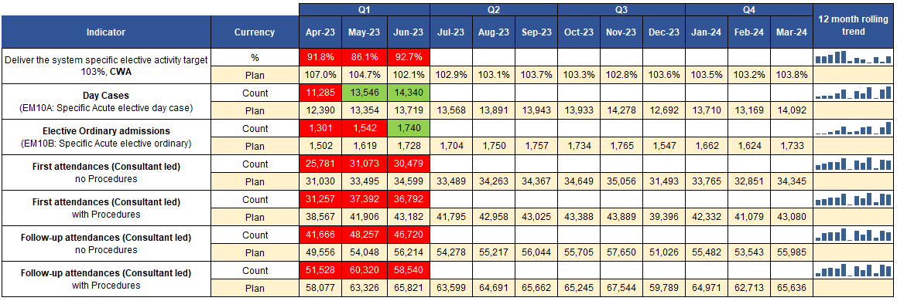
Elective Recovery – Key Dashboard Metrics (1/2)
Summary
Nationally the cost weighted activity (CWA) target is to revise down, due to industrial action. Issues with uncoded data continue to impact on performance.
Day cases and ordinary admissions are above plan.
First and follow up attendance activity are not meeting plan. Outpatient transformation is now in tighter focus to achieve the 25% reduction needed.
At UHNM the patient initiated follow up initiative (PIFU) is meeting expectations but not providing a real drop in follow-up’s; the discharge to PIFU pathway is reporting low numbers, which need to increase. This relates to a target given to providers (5% of patients being discharged to PIFU) which UHNM are achieving, but it isn’t resulting in a reduction in follow-ups required. There is a difference between patients being put on a PIFU pathway (where they are not discharged) and being discharged to PIFU, where patients are discharged but can contact for a follow-up for a time limited period post-surgery - the latter is to be focused on.
Notes:
Slide updated by BI team w/c 14/8.

Slide 23
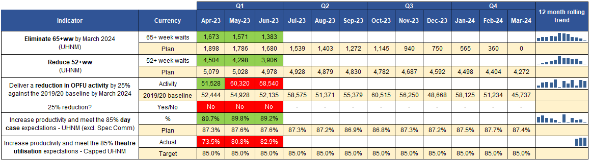
Elective Recovery – Key Dashboard Metrics (2/2)
Summary
65+ week waits decreased in June at ICB level to 1,383. Weekly data shows a continued downward trend at UHNM (recovery pack w/e 13th August) which is below their target. UHNM note 31.3% of patients in the March 2024, 65+ week cohort are still awaiting their first appointment.
52+ week waits – below plan at UHNM. Waits have been significantly validated, as part of the wider work to process all unvalidated long waits (which may increase long waits). UHNM continues to work backwards in validating current long waiters, and to validate all those that are predicted to breach 52 weeks by March 2024, if untreated.
The quality team have completed a deep dive into elective long waits and harm; no direct harm was noted as a system. The harm review processes at UHNM are to be refreshed in September to provide continued assurance to the ICB
As at w/e 13th August two 104+ week waits are noted across the ICB. UHNM (recovery pack w/e 13th August) predict two 104+ week waiters at the end of August (one patient has a TCI 17/8) and zero in September.
UHNM recovery pack (w/e 13th August) indicates 78+ week waiters at the end of August, are predicted to be 168; this is a pre industrial action position and is therefore not expected to be maintained for month end (early indications is that this will be around 170).
Outpatient follow up appointments remain above the 19/20 baseline and are not 25% below as is required.
Day case rate at UHNM remains above plan.
Theatre Utilisation at UHNM is capped and below the target (of 85%) and the plan. From the latest UHNM data (recovery pack w/e 13th August):
  Capped utilisation was 74.57%. The 44 ‘on the day’ cancellations represent 8.7% of total activity.
  Junior doctors strike resulted in 41 closed sessions (across both sites) for w/e 6th August.
Notes:
Slide updated by BI team w/c 14/8.

Slide 24
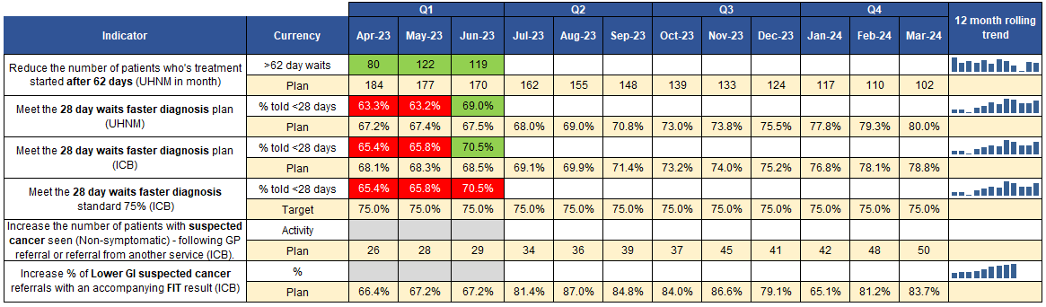
Cancer – Key Dashboard Metrics
Summary
62 day breaches UHNM decreased to 119 in June and is below the plan (of 170). The 62 day backlog as at w/e 13th August 2023 is 501 (UHNM recovery pack) well below the revised trajectory of 606 – both increasing on last week..
The UHNM 104+ day backlog has reduced to a current position (for w/e 13th August) of 148 (weekly recovery pack, w/e 13th August).
The 28 day faster diagnosis standard (FDS) overperformed against plan at UHNM (by 1.5%). The latest report from UHNM (weekly recovery pack, w/e 13th August) reported that the FDS was impacted in June by poor performance in Colorectal, Gynaecology, Haematology, Head & Neck and Sarcoma.
The plan to bring the 28 day FDS to the target (75%) by Q3 2023 is in place at UHNM. The key actions in Q2 are:
  Continue to expand and optimise new community pathways,
  Allocate funding to radiographers to support expansion in the workforce and skill mix,
  Referral optimisation,
  Improve GP access to fast track imaging.
28 day FDS Colorectal performance is in focus – the ICB is working with an independent provider to help improve performance, a contract is in draft.
A change to the national cancer standards in year will change reporting. The ICB is awaiting confirmation from NHSE and the CSU regarding the proposed changes, however, it will not affect our cancer service delivery.
Please note: Data on non-symptomatic suspected cancer referrals is not available at present, data on Lower GI referrals with FIT test is currently not available for this financial year.
Notes:
Slide updated by BI team w/c 14/8.

Slide 25
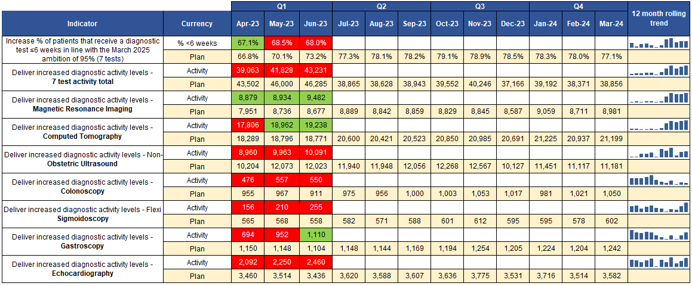
Diagnostics – Key Dashboard Metrics
Summary
Diagnostics test performance (% of patients seen in <6 weeks) reduced in June and remains below the plan (by 5.2%).
The number of patients seen in >6 weeks is greatest in Ultrasound (32.6% of all in month), Echocardiology (23.4%) and Colonoscopy (11.1%).
UHNM (Recovery Pack w/e 13th August) DM01 13+ week breach cohort, 9.6% (2,153) do not have a ‘to come in’ (TCI) date. 13+ week breaches (same data source) are greatest in Colonoscopy (918), Flexi Sigmoidoscopy (698) and Gastroscopy (645).
Endoscopy 6 week and 13 week breaches are above trajectory at University Hospitals North Midlands in June (data from their Recovery Pack w/e 13th August).
MRI, CT and Gastroscopy activity in June exceeded the plan – the only three tests to do so this month.
Notes:
Slide updated by BI team w/c 14/8.

Slide 26
IPH Portfolio – Key Headlines including any escalations
Report to Follow

Slide 27
UEC Portfolio – Key Headlines including any escalations
OPERATIONAL / RECOVERY | TRANSFORMATIONAL | WORKFORCE, DIGITAL & ESTATES
Access Group Projects rated AMBER as performance is challenged Single Point of Access discussions commenced VW Sitrep available now demonstrating system beds available In Hospital – UHDB Projects rated AMBER as performance is challenged NEL improvement plans refreshed, new priority areas identified. Revised governance structure implemented. Operational performance (4 hours) continues to improve in line with the Trust recovery plan trajectory – 71.75% for July. In Hospital – UHNM Projects rated AMBER as performance is challenged 4 and 12 hour performance not demonstrating improvement month on month – mitigations in place via UHNM plans. Provider confident plans will result in improved performance but acknowledge may take time. Action to agree timescales for this to support effective monitoring. Integrated Discharge Steering Group Projects rated AMBER as performance is challenged IDH Director appointed – start date to be agreed Hub site identified and on track for “go live” date of 04/09/2023 Surge Projects rated RED to reflect significant challenge identified – 100 unmitigated bed gap | See Urgent Treatment Centre update on next slide | Ongoing risks at a score of 15 and above 098 –Workforce/Staffing 104 –Scheme De-escalation plans 132 – Mobilisation of System Surge capacity Access: Workforce – recruitment and sustainability within Acute Care at Home (AC@H).
FINANCE, CONTRACTING & PROCUREMENT | QUALITY | REQUESTS FOR ANOTHER PORTFOLIO / ENABLER
Winter Plan forecast spend shows material pressure against the allocation received based on current de-escalation plans and the assumption that schemes for 23-24 are consistent with those used in the 22-23 winter period. GP OOH – Remedial Notice issued and meetings held with Provider in regards to recovery plan. Plan to be agreed by 11/08/23 NEPTS – Performance concerns raised at CRM. Provider has submitted plans to address issues. Currently under review NHS 111 – Procurement for region wide service from April 2024 has reached a stage where outcome is expected by the end of August 2023. WMAS – crews on duty – Black Country made formal request to WMAS to include within their reporting schedule | Ongoing risks at a score of 15 and above 106 – D2A Capacity 111 –Ambulance Handover | Interdependencies identified with : ELF portfolio – metrics for Frailty and Palliative and End of Life Care to be agreed as part of System Recovery plan. Care Homes within integration Access Programme within Primary Care Portfolio
ESCALATIONS
Access: Workforce – recruitment and sustainability within Acute Care at Home (AC@H). Work commenced re re-setting priorities for AC@H Team. Data dashboard developed to inform VW utilisation discrepancies across SSOT. North VWs are operating well at 80%, low utilisation in the South West and South East where medical cover is run by RWT and UHDB respectively. Stocktake of ACAH offer, diagnostics and priority plan going to UEC Board in August, In hospital – recognition of deterioration of 4hr and 12 hr up to July at UHNM. Quality Improvement methodology in place, it is on in hospital radar and will be escalated for action if improvement not yielding by October 23. Need to allow time for embedding practice. IDSG – plans required to be developed to identify priorities and interventions for the IDSG to allow for monitoring – this project directly relates to performance within Surge and Recovery Surge – Residual bed gap (with mitigations) currently stands at -80 beds– escalation to CEOs week commencing 14/8/2023 to identify immediate additional actions. Visibility of BCF and system Financial Position required and remains gap and risk. System wide financial position including position of LAs remains a challenge to developing plans De-escalation of Winter Surge capacity 22/23 – some 22/23 surge capacity remains in place Attendance at UEC Delivery Group – meeting went ahead on 09/08/2023 but was not quorate. Prioritisation of this meeting requested so representatives from all partners are in attendance

Slide 28
UEC PROJECT RAG STATUS AT A GLANCE
PROGRAMME / PROJECT TITLE | RAG STATUS
Access Programme Review Full review of the Access Programme with a view to enhancing provider collaborative offer to include the Clinical Assessment Service Full review and priority setting for Virtual Wards | A
2. Acute Hospital Flow Progress capital investment business case for 50 additional beds at RSUH – essential to close the peak capacity gap in winter 2023/24 Work with UHNM on the UEC improvement programme to improve acute hospital flow and delivery the 76% ED standard, the 92% occupancy target and improve ambulance handover delays | A
3. Integrated Discharge Hub Delivery a fully integrated discharge “hub” with a single operational tasking structure and physical co-location Improve the discharge profile and targets and achieve a consistent 7 day service | A
4. System Capacity and Demand Request to NHSE for capital capacity 50 beds at RSUH Haywood D2A reconfiguration | R
5. Frailty | ELF Portfolio
6. End of Life Pathways | ELF Portfolio
7. Primary Care Access Enhanced Access Digital Care Navigation Same Day Access | Primary Care Portfolio
8. Mental Health Crisis Care Pathways Mental Health Response Vehicle – available during Q3 | Mental Health Portfolio
PROVIDER COLLABORATIVE OPPORTUNITIES | RAG STATUS
Acute Care at Home (incorporating CRIS, Falls Management and Virtual Wards) | Stage 3
STRATEGIC TRANSFORMATION PRIORITIES – UEC Portfolio | RAG STATUS
Urgent Treatment Centres
Technical event to refine shortlist – Aug/Sept | On Track
Develop Case for Change – mid September | On Track
NHSE Stage 1 Assurance Meeting – 14th September | On Track
Cannock Transformation Programme
Feasibility of relocation of GP practices | On Track
Feasibility of relocation of MRI Scanner | On Track
Feasibility of relocation of Community Services | On Track
Implement temporary building – due November 2023 | On Track

Slide 29
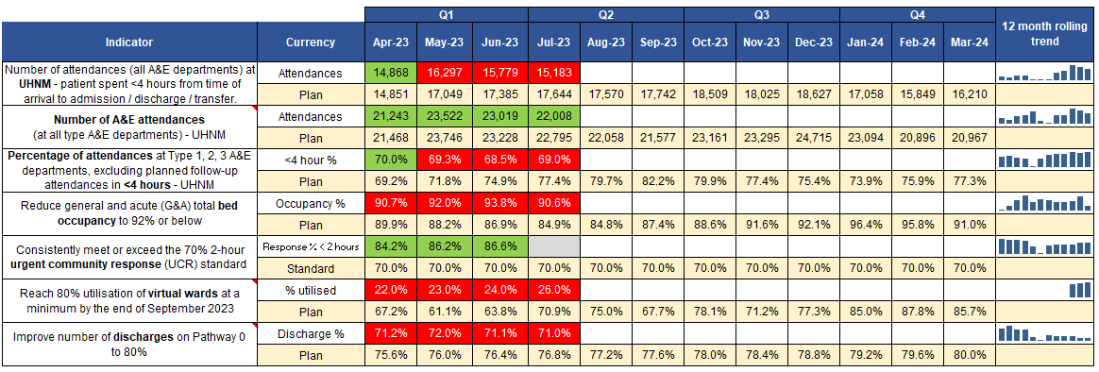
UEC Portfolio – Key Dashboard Metrics
Summary
Emergency Department (ED) Attendances reduced by 4.4% over the previous month and were 3.4% below the plan.
4 hour ED Performance increased despite continuing high levels of Emergency Admission.
5 year forecasts, factoring in population growth, of Type 03 coded activity for the ICB across UHNM, University Hospitals Derby and Burton and The Royal Wolverhampton Trust sites have been completed and shared with the respective organisations.
Additional work has been requested to remodel activity including Type 01.
Occupancy levels recorded on the Virtual Ward Sit Rep for the last fortnightly submission showed 26% occupancy which is skewed by utilisation variations between areas.
For the fortnight ending 20th July the North saw rates of 70% in General Medicine and 73% in COPD, whilst the East reported 23% and the South West 0%.
Notes:
Slide updated by BI team w/c 14/8.

Slide 30
MHLDA Portfolio – Key Headlines including any escalations
OPERATIONAL | TRANSFORMATIONAL | WORKFORCE, DIGITAL & ESTATES
Wave 7 Mental Health Support Team (MHST) is mobilised and servicing schools in the Tamworth area. Wave 9, covering Lichfield schools is expected to go live in Sept 23. | MH UEC/Crisis workshop scheduled for Sept 23 to scope programme of work MH/111 Option 2, on track for soft launch Sept 23. Arrangements in place for current 111 provider to take/triage calls until end November 23. Recruitment to new posts underway, expected in post by December 23. National Partnership Agreement for Right Care, Right Person now released, implementation plan under development. CYP MH Local Transformation Plan refresh underway, expected at September Delivery Group meeting. LDA Steering Group established from Sept 23 to pull all workstreams of the LDA Programme together. Annual Health Check promotion at Burton Albion completes 3 roadshows supporting the LDA Identification workstream. Initial linkages made between LDAP and SEND Delivery Groups. LDA Identification PIP under development and at final draft stage. LDA Comm’s campaign to support reasonable adjustments for LDA launch date 5th October 23. LDA Community Services follow up workshop scheduled Sept 23 to map quick wins and propose priorities for 23/24 SDF expenditure. | The Lotus Service within Southern Staffordshire, delivering MH support to those living through pregnancy and baby loss, birth trauma and tokophobia (fear of childbirth) is experiencing workforce challenges. Availability of workforce to implement NHS 111/MH option 2 within nationally directed timescales. c59% of SSOT staff have completed the Oliver McGowan eLearning, the next stage will be co-delivered with experts by experience and a proposal is currently under discussion.
QUALITY | FINANCE, CONTRACTING & PROCUREMENT | REQUESTS FOR ANOTHER PORTFOLIO / ENABLER
Temporary suspension, until September 23, for new referrals to the Lotus Service within Southern Staffordshire which delivers mental health support to those who are living through pregnancy and baby loss, birth trauma and tokophobia (fear of childbirth) due to workforce challenges. Current patients are being reviewed and will be contacted if there is any change to their provision of care. Commissioning Framework for MH Inpatient Services released to inform MHLDA Quality Inpatient Transformation Programme. Draft 3 year Strategy submission to NHSE, now Mar 24. Escalation raised by NSCHT in relation to waiting times for ASD within the North of Staffordshire. Further discussions underway. | There is £919k of LDA SDF funding still to be committed for 23/24. NHSE have indicated that if this money is not used solely for LDA then it will be recouped centrally. Funding of £262k is expected to be received by the ICB for the Oliver McGowan Mandatory Training, work underway with the system workforce group and partners to optimise the delivery of this training. Options currently under consideration Independent sector ADHD assessment and ongoing treatment continues to be a cost pressure of £1.2m. A TCP patient placement with complex needs has been agreed as an exceptional case, resulting in a £1.2m cost pressure for 23/24 which equates to a full year effect of c£1.6m. The TCP forecast for patient placements managed by NSCHT is currently matching the plan with the £1.4m system efficiencies which are expected to be achieved. Project 86 is currently forecasting underspend of £2.4m. MHA S117 is currently forecasting an overspend of £6.5m in line with increased activity. Post vention service procurement completed and provider appointed. Service to go live Autumn 23. MHLDA Delivery Group agreement to the procurement of S12 solutions via G Cloud | Support from Digital Programme as an enabler for the roll out of the Digital Flag and Reasonable Adjustment Flag for people with LDA Primary Care support r.e validation of GP LD Registers and increased Annual Health Checks Meds Optimisation support for the STOMP/STAMP agenda Support from primary care and Med Ops around ADHD ESCA'a and directing referral to new Adult ADHD service.
ESCALATIONS
None
Notes:
Slide updated by BI team w/c 14/8.

Slide 31
MHLDA PROJECT RAG STATUS AT A GLANCE
PROJECT (PIPs) TITLE | RAG STATUS
LDA Identification | Scoping – Final Draft
LDA Dedicated Care and Support | Scoping
LDA Community Services | Scoping
MH/111 | On Track
PROVIDER COLLABORATIVE OPPORTUNITIES | RAG STATUS
Still being scoped
STRATEGIC TRANSFORMATION PRIORITIES – MH and LD&A Portfolio | RAG STATUS
INPATIENT MENTAL HEALTH SERVICES
Public Consultation Exercise | Complete
Report of Findings | Complete
Impact Assessments completed | On Track
Development of DMBC | On Track

Slide 32
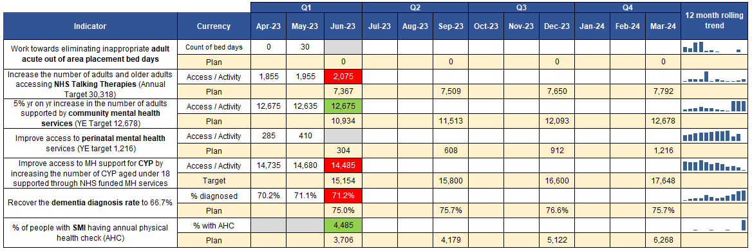
Mental Health – Key Dashboard Metrics
Summary
There were 30 inappropriate adult acute Out of Area Placement bed days – above the Q1 plan. A number of key actions are underway beginning with Stage 1 Analysis: April - June 23 reviewing information on bed demand and capacity including, Inpatient Bed Strategies; and understanding system challenges. Building to proposals for implementation from November 2023.
Access to NHS Talking Therapies was 5,885 across Q1, below the plan by 1,482 (20%). Work continues to increase access, including extensive promotion of the service, use of a bus to target underrepresented groups and areas with poor transport links. Digital promotion to increase online self-referral and use of digital devices for older adults to overcome barriers to access.
Access to Specialist perinatal community mental health services – June data has not yet been refreshed on the national dashboard.
Access to Children and Young Peoples (CYP) community mental health services was below the Q1 plan by 669 (4%). North Staffordshire Combined Healthcare NHS Trust (NSCHT) is investigating a downward trend in activity.
The Dementia diagnosis rate for the ICB continues to exceed the 66.7% national target, but is below the Q1 plan by 4%. Staffordshire sub ICB locations jointly met the national target but were below the plan, whilst Stoke-on-Trent exceeded both. Work continues to identify and understand variations in diagnosis rates across the ICB. Diagnosis rates are discussed with stakeholders at both north and south Dementia Forums.
Please note: For several metrics, the latest data is provisional and subject to change (CYP MHS access, Adult MHS access, Perinatal MHS access, NHS Talking Therapy access).
Notes:
Slide updated by BI team w/c 14/8.

Slide 33
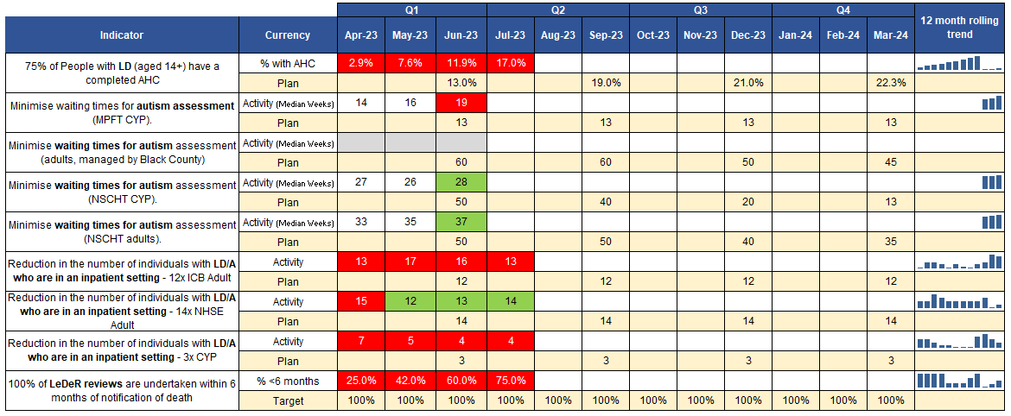
Learning Disabilities and Autism (LD&A) – Key Dashboard Metrics
Summary
Patients with Learning Difficulties and Autism (LD&A) with an annual health check (AHC) – M4 position at 17%, remaining below plan. Practices are encouraged to spread the number of health checks throughout the year, however the 12-month recall process results in more activity taking place during Q3 and Q4.
Autism Waits: Increased case load at Midlands Partnership Foundation Trust (MPFT) in Children and young people (CYP) and at North Staffordshire Combined Healthcare Trust (NSCHT) in CYP and Adults, the median wait time for assessment has also increased for June.
LD&A adults: ICB total is above the Q2 target of 12, with 13 inpatients. NHSE Adults equal to the[Q1] target of 14, with 14 inpatients in July.
LD&A CYP: CYP inpatients has continued to decrease but remains above the [Q2] target of 3, with 4 inpatients.
(LeDeR) reviews were completed within 6 months for 75% of people with a learning disability and/or autistic people, below target but improving each month as per new process.
Notes:
Slide updated by BI team w/c 14/8.

Slide 34
Primary Care Portfolio – Key Headlines including any escalations
OPERATIONAL / RECOVERY | TRANSFORMATIONAL | WORKFORCE, DIGITAL & ESTATES
Access GPAD data deep dive on appointments per 10,000 patients (learning & improvement) Improvements noted around PCN work around DNA’s – priority areas for focus work being identified Public communications campaign went live on 07 08 2023 Primary Care Access Recovery Plan - 25 PCN Improvement Plans signed off by 31/7/23 – themes and trends identification work commenced Commissioning – on track Care home Survey distributed to PCNs 16 08 2023 to capture the work taking place Facilitation of Admission Avoidance (FAA) LIS letter going out early September with updated requirements and outcomes | OD – on track Maturity matrix work – undergoing stakeholder engagement – small risk may not be embedded by October Ongoing work re. Action learner sets and leadership development offer Finalise funding for DISC profiles to be identified (awaiting budget codes) Digital – on track Timing launch of framework is problematic but a clear plan is now in place with national procurement team supporting. Online consultation and video consultation procurement route now clear. Existing contracts to be extended in light of framework launch delay and mitigate any impact to practice/patients use of services. Primary Care Access Recovery Funding mechanism to recover costs for services from April 2023 to date now shared and being drawn down. Remaining funds to be used to extend contracts. Cloud Based Telephony engagement sessions planned with all 7 practices where funding has been secured to make move from analogue. On track and national procurement route supporting practices to get best available costs/functionality to deliver this key project. | Workforce PCN workforce plan being submitted by deadline 31/8/23 Strategy development underway via WIG by end of financial year ARRS funding utilisation – process developed to promote utilisation commenced Estates – on track Continued work on estates plans process and the “so what” next steps? Communications and outputs being identified to highlight work completed through the PCN estate plan process
QUALITY | FINANCE, CONTRACTING & PROCUREMENT | REQUESTS FOR ANOTHER PORTFOLIO / ENABLER
New Risk to be added to Risk Register No funding identified to resource General Practice Surge Plan for winter period | Lack of contracting support in place for enhanced services contracts Options appraisals for 2 x current APMS contracts to go to Primary Care Forum in September / October 2023 Burntwood Health and Wellbeing list dispersal process being followed | Estates Completion date for PCN Estate Plans pushed back to 31/07/2023 – expectation to complete by end of September 2023
ESCALATIONS
Workforce – challenges and utilisation of ARRS funding ongoing Commissioning – activity validation work – some missing reports line by line savings £862,000 LES identified (against £1.5m target) - £300,000 LES money yet to be identified (SMI not hitting targets – need to review specification and digital in place) Winter – winter surge plan has been identified for primary care – risk around finance associated, no additional funding provided.

Slide 35
PRIMARY CARE PROJECT RAG STATUS AT A GLANCE
PROJECT (PIPs) TITLE | RAG STATUS
Access (including Same Day Urgent Primary Care) | G
Digital and IT | G
Estates | G
Quality & Safety | A
Contracting | G
Commissioning | G
Organisational Development | G
Workforce | A
Winter / Surge | R
PROVIDER COLLABORATIVE OPPORTUNITIES | RAG STATUS
Shared Care Medicines Collaborative | Stage 1
Integrated Neighbourhood Teams | Stage 1

Slide 36
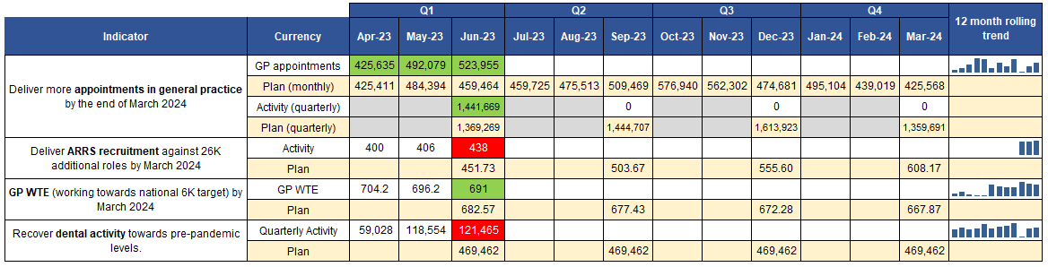
Primary Care – Key Dashboard Metrics
Summary
GP appointments are above plan in M3, delivering 114% of planned activity (64,491 appointments above the plan). Variations in practice working methods and appointment book management can impact the quality of the data captured.
Additional Roles Reimbursement Scheme (ARRS) stands at 438 Full Time Equivalent (FTE) for June 23 – below the Q1 plan. The FTE continues to increase month-on-month. Significant work is being undertaken to improve the accuracy of ARRS reporting and claims. A proportion of ARRS roles are currently not reported in the National Workforce Reporting Service (NWRS). The national team are in the process of making system changes to align the roles. Local data from the ARRS claims portal suggest the ARRS FTE figure stands at 557.2 for June 2023. April to July 23 shows an underspend against the ARRS budget, utilising 75.8% of the budget (spend for 3 PCNs outstanding for July 23). Additional Roles Reimbursement Scheme (ARRS) task and finish group have developed a plan with the aim to maximise the spend of the budget thus increasing workforce capacity within general practice. This includes a bidding process across PCNs for underspend which has been agreed through PC forum with input from the North and South Staffordshire LMCs.
GP whole time equivalent (WTE) decreased in June but is above the Q1 plan. Primary Care workforce implementation group will be considering the national workforce plan in September and mapping data to the work programmes to demonstrate impact. Continued work ongoing with Retention Coordinator to look at recruitment processes and health and wellbeing to attract and retain the staff in primary care.
Dental – The contracted Units of Dental Activity (UDAs) are increasing but are well below the Q1 plan by 347,997 units. April is reduced as it is effectively a part month (dental scheduling runs week 3 to week 3).
Notes:
Slide updated by BI team w/c 14/8.

Slide 37
E.L.F. Portfolio – Key Headlines including any escalations
OPERATIONAL / RECOVERY | TRANSFORMATIONAL | WORKFORCE, DIGITAL & ESTATES
Since the previous System Highlight Report submission, the ELF Portfolio has been largely focussed on rapid action to support System Recovery for winter, by request of our SRO. This includes development of Project Initiation Plans for: Continuing Healthcare - improved patient pathway for patients needing bed based care at the end of life. Palliative and End of Life – work with practices to ensure that their End of Life registers are up to date in terms of identification and are being actively monitored / managed. 24/7 patient access, 24/7 healthcare professional and 24/7 rapid response. Severe Frailty – Enhanced care of severely frail patients in care homes and domiciliary settings Falls – ED departments to maximise usage of Specialist Falls (RED) pathways to reduce ED attendances Progress is monitored through weekly ELF Recovery Group – Chaired by ELF SRO Steve Grange. | We have spilt the portfolio in to recovery and transformational plans. Our recovery programme is the priority for August. We are ensuring that the day to day running of the transformation elements of the portfolio are being monitored and work is being picked up on a priority basis to ensure progress is ongoing | Nothing to report.
QUALITY | FINANCE, CONTRACTING & PROCUREMENT | REQUESTS FOR ANOTHER PORTFOLIO / ENABLER
Quality oversight including completion of relevant QIAs will be included in the Recovery programme of work. | Actions from the line by line are now been taken forward through the portfolio MDT and reported through the ICB efficiency oversight meeting. Downstream pressures have also been identified in 4 areas and mitigation schemes being worked up. These have been reported via the ICB efficiency oversight meeting. | There is recognition there are a number of NSHOF metrics that will sit in other portfolios in particular primary care that ELF will need to support the delivery of. Primary care regarding QIF (LTCs and PEoLC) and Moderate Frailty Outcomes roll out. Integration supporting 24/7 advice and guidance being developed with UEC Portfolio.
ESCALATIONS
All portfolio work relating to the ops plan has been scaled back temporarily till the end of August to enable us to meet the needs of the priorities for the system, by way of the ELF recovery plan. However we endeavour to pick this back up in full flow from September.

Slide 38
E.L.F PROJECT RAG STATUS AT A GLANCE
PROJECT (PIPs) TITLE | RAG STATUS
FRAILTY PROGRAMME
Prevention & Mild Frailty (Transformation) | On Hold
Moderate Frailty (Transformation) | On Hold
Severe Frailty – part of Recovery Programme | Green
Falls Prevention – part of Recovery Programme | Green
LTC PROGRAMME
Respiratory, CVD and Diabetes Projects (Transformation) | On Hold
PROJECT (PIPs) TITLE | RAG STATUS
PALLIATIVE AND END OF LIFE PROGRAMME
Identification/Quality Care Planning & Co-ordination & Integration – part of Recovery Programme | Green
KEY PORTFOLIO METRICS FOR MONITORING IN 23/24 | BASELINE | TARGET | M1 | M2 | M3 | M4 | M5 | M6 | M7 | M8 | M9 | M10 | M11 | M12
PEoLC- Identification of Patients in the last 12 months of life recorded on Palliative Care Registers in Primary Care increased from 0.5% | 0.5% 21/22 and mid Mar 23
LTC -We will endeavour to enrol 85% of those referred for PR (pulmonary rehabilitation) with stable COPD (chronic obstructive pulmonary disease) within 90 days | N/A
LTC - Ensure 70% of patients enrolled for PR go on to complete the programme and have a discharge assessment. | N/A
LTC - 8 care processes - increased offer rollout to those with Diabetes | Only 37.7 % reach, based on data from 21/22.
LTC - Patients who are identified of having a 20% or greater increased chance of developing CVD (Cardio Vascular disease) are treated with Statins. | Only 57.4% reach, based on data from 21/22
LTC – AF – 10% Increase screening/identification (Pulse Check) | Baseline 32% mid-March 2023
Frailty - 10% increase in the number of people with severe frailty who have a completed ReSPECT document and an Anticipatory Care Plan. | Baseline data from 4 practices show only 28% had ReSPECT & 30% have ACP
Frailty - 90% completion rate of the Clinical Frailty Scale (Rockwood) for each moderately frail patient assessed as part of the Staying Well Service and Facilitated Admission Avoidance Scheme Frailty - 10% increase in the number of people accessing self help and support under prevention service offer, Staffordshire County Council service adult social care webpages, Staffordshire connects and community health partnerships. | N/A Based on performance end of 22/23 the baseline is 5714
Metrics under development to support System Recovery Programme

Slide 39
Appendix 2: Efficiency Delivery Plan
Leads outline in the following slides oversight on the efficiency programme performance, current status on actions and key headlines including any escalations covering covering Estates, CHC and Medicines Optimisation.

Slide 40
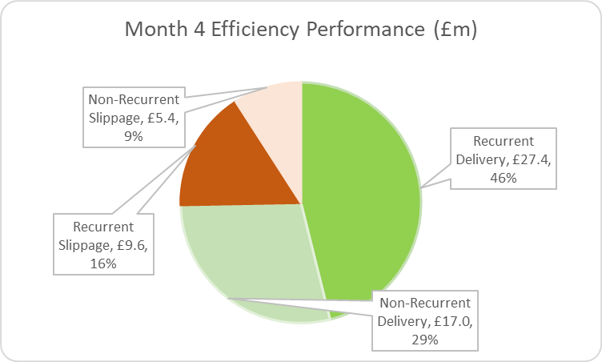
Efficiency programme summary
The system has delivered £44.5m of efficiency as of July 2023, 75% of plan, which is an 11% increase on last months delivery levels.
Forecasts project the system will recover most of this position by year end, although there is a high level of risk within this forecast due to the size of the efficiency target within the plan.
Key issue is the slippage in programmes YTD has increased the unidentified forecast for which plans are required in order to deliver in year.
Specific actions
Notes:
Steff, Helen and Matt.

Slide 41
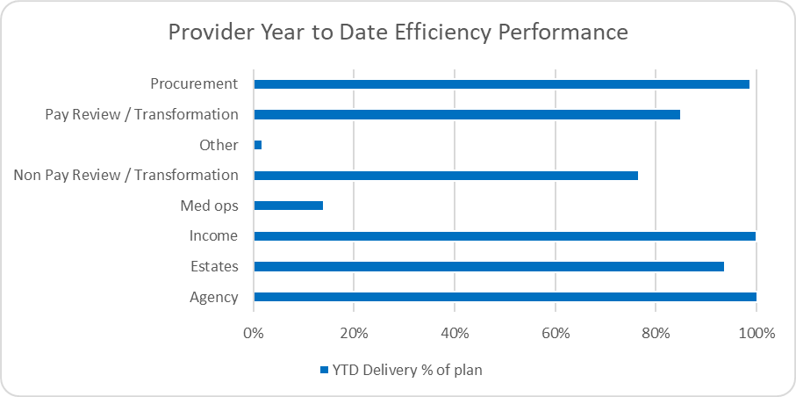
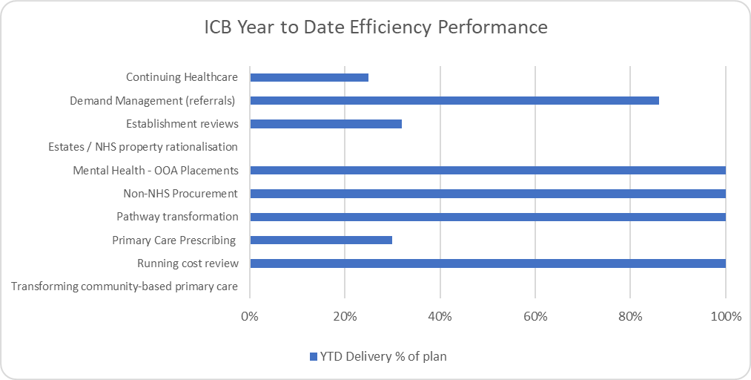
Efficiency programme performance
Specific actions
Key challenges remain to deliver recurrent efficiency within the current environment.
We currently have a £12.7m forecasted shortfall of recurrent schemes. This has improved by £15m from last months forecast.
The following details the delivery of efficiency programmes by theme, splitting by providers and the ICB programmes.
Notes:
Steff, Helen and Matt.

Slide 42

Current status on actions within the efficiency programme delivery plan
Supporting Mechanisms
Double Lock and Cost Control – principles agreed by Senior Leadership Team (SLT) and adopted. Governance arrangements to be confirmed. Line by Line review – programme concluding with £4.78m in year savings identified + additional £4.56m of future opportunity subject to portfolios developing and implementing action plans to release opportunity. System Efficiency & Productivity Reporting – arrangements in place with reporting through Performance and Programmes Report which is used by SPG, F&PC and the SLT to agree actions. Management Consultancy and Agency Staff control – arrangements in place following the NHSE process Income Top Slice – principles agreed by SLT and adopted. Governance arrangements to be confirmed. Working across health and social care – partners work constructively, but system costs for CHC / social care continue to rise so need for system work to agree actions including bringing provision from Midlands and Lancashire Commissioning Support Unit.
Specific Actions
  Delivery of CIP / efficiency – all organisations working up delivery plans. Behind plan at month 3 and still material levels of unidentified savings.
  Management Costs / Enabling Functions – individual work programmes being established for digital and estates and CSU supporting opportunity assessment for other functions.
  Medicines – steering committee established with a clear remit to ensure delivery of current efficiencies and seek opportunities where potential savings can be maximised or accelerated by cross system working.
  Annual Leave Accrual – principle agreed by SLT and adopted. Organisations starting to transact but with concerns about operational impact and potential need for consultation.
  The two areas of focus - Avoiding Admissions / Improving Discharge – many projects already in train but system looking to commission consultancy partner to expedite implementation.
  Maximise ERF – monitoring arrangements established. Concerns regarding contract challenges from providers on the split between fixed and variable elements of the contract. Industrial action will lower the threshold nationally.
Notes:
Steff, Helen and Matt.

Slide 43
System Efficiency Programmes – Key Headlines including any escalations
PROJECT DELIVERY UPDATE | QUALITY UPDATE (INCLUDING QIAs) | PERFORMANCE UPDATE
CHC – 4 key workstreams now in place. First meetings to start in September. Estates system workshop took place on 18/07/23 to identify and agree key areas of focus. Leads for each workstream have been aligned. The first Strategic Group has been arranged for 08/09/23. Medicines Optimisation Steering Group met formally for the first time on 11th August. Programme of work under development | CHC policy requires the correct level of consultation and engagement, survey now launched w/c 14th Aug, closing on 10th September. | Metrics for CHC still to be agreed Metrics for Estates will be agreed for each of the priority workstreams, during scoping phase. Timescales to be agreed at Strategic Estates Group. Metrics for Medicines Optimisation to be agreed
CONTRACT / PROCUREMENT UPDATE | FINANCE UPDATE | REQUESTS FOR ANOTHER PORTFOLIO / ENABLER
None | CHC predicted a forecast of £62m overspend at M2, this has reduced in M4 with a forecast outturn position of £256.3m against the annual budget of £203.2m. Therefore the forecast overspend is £53.2m | None
RECOMMENDATIONS / ITEMS REQUIRING APPROVAL
None

Slide 44
Medicines Optimisation - Key Dashboard Projects / Metrics
Still in development
UHNM CIP Plans | RAG STATUS
CMU Savings (rollover from 22/23) | TBC
CMU Savings 23-24 | Awaiting medicines to be included / cost calculator
Adalimumab biosimilar switch | TBC
ICB CIP Plans | RAG STATUS
Medicines Optimisation SLA | Green
Centralised Repeat Prescription Management Service | Scoping underway
Community Pharmacy Common Conditions | Scoping underway
RWT Opportunities – Adalimumab biosimilar switch | Needs scoping
UHDB Opportunities Adalimumab biosimilar switch | Needs scoping
Combined Healthcare CIP Plans | RAG STATUS
TBC
MPFT CIP Plans | RAG STATUS
Adalimumab biosimilar switch
System Wide Initiatives in addition to Trust plans | RAG STATUS
TBC following system event on 14th July
KEY METRICS FOR MONITORING IN 23/24 | BASELINE | TARGET | M1 | M2 | M3 | M4 | M5 | M6 | M7 | M8 | M9 | M10 | M11 | M12
e.g. 90% eligible patients switched to appropriate biosimilar within 12 months
Notes:
Alex, Helen and Matt.

Slide 45
Continuing Healthcare - Key Dashboard Projects / Metrics
CHC WORKSTREAMS | RAG STATUS
Continuing Healthcare – Value for Money Workstream | R
Continuing Healthcare – Quality Workstream | A
Continuing Healthcare – Partnerships Workstream | A
Continuing Healthcare – Governance and Workforce Workstream | A
Still in development
KEY METRICS FOR MONITORING IN 23/24 | BASELINE | TARGET | M1 | M2 | M3 | M4 | M5 | M6 | M7 | M8 | M9 | M10 | M11 | M12
TBC

Slide 46
Estates - Key Dashboard Projects / Metrics
Still in development
ESTATES WORKSTREAMS | RAG STATUS
Utilisation | In scoping
Leases | In scoping
Surplus Assets | In scoping
Solar Panels | In scoping
System Strategy (external resource) | Resource being sourced
KEY METRICS FOR MONITORING IN 23/24 | BASELINE | TARGET | M1 | M2 | M3 | M4 | M5 | M6 | M7 | M8 | M9 | M10 | M11 | M12
TBC

Slide 47
Appendix 3:
National NHS objectives 2023/24 Performance
ICB / Provider
The following tables provide detail on activity and/or performance in relation to the operational plan and/or target. Red shading denotes underperforming and green over-performing.

Slide 48
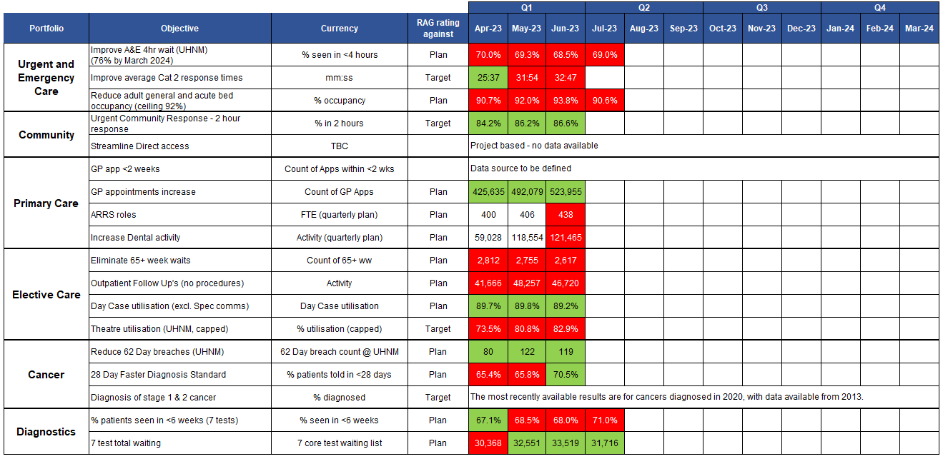
National NHS Planning Objectives 2023/24 – ICB / Provider (1)
Please note: Diagnostics data for July is preliminary data and so subject to change. Please use as a guide only.
Please note: The objective ‘Streamline Direct access’ is action and not metric focussed so is proposed for removal from this table or performance metrics.
Notes:
Slide updated by BI team w/c 14/8.
Diagnosis of stage 1 and stage 2 cancer metric – Mike has the 2020 data if we want to mention this in the SPG. Discussed about are we assured that actions in place will have some impact on this measure in x years team?

Slide 49
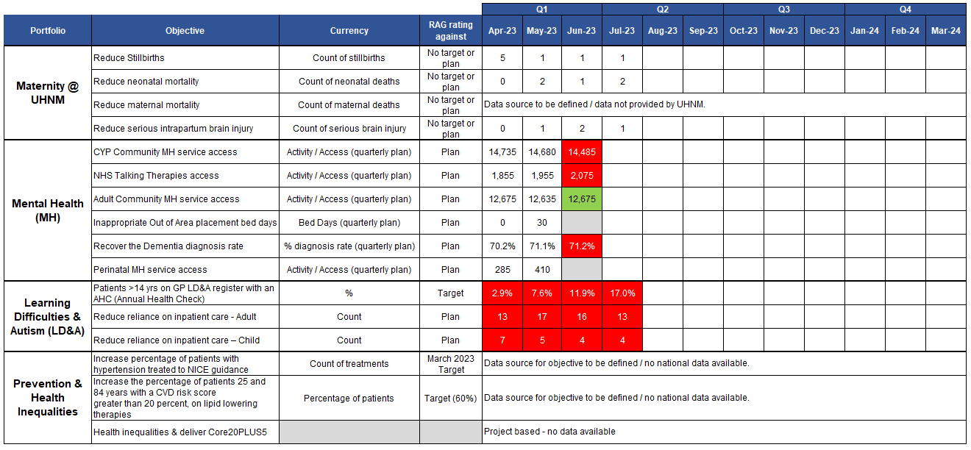
National NHS Planning Objectives 2023/24 – ICB / Provider (2)
Please note: The objective ‘Health inequalities & deliver Core20PLUS5’ is action and not metric focussed so is proposed for removal from this table or performance metrics.
Notes:
Slide updated by BI team w/c 14/8.

